Slide 1
Orientation Workshop on Outcome Based Education & Accreditation
10th October, 2024
Prof. R. V. Ranganath,
Former Professor, BMS College of Engg.
Bangalore
Self Assessment Report (SAR) - 2024
Undergraduate Engineering Programs
(GAPC V 4.0)
(TIER-I – Institutions)

Slide 2
Washington Accord Graduate Attributes (Revised Ver. 4.0 Vis-a-Vis Existing Ver. 3.0)
Differentiating Characteristic | GAPC 4.0 … for Washington Accord Graduate | GAPC 3.0 … for Washington Accord Graduate
Engineering Knowledge: Breadth, depth and type of knowledge, both theoretical and practical | WA1: Apply knowledge of mathematics, natural science, computing and engineering fundamentals and an engineering specialization as specified in WK1 to WK4 respectively to develop the solution of complex engineering problems. | WA1: Apply knowledge of mathematics, natural science, engineering fundamentals and an engineering specialization as specified in WK1 to WK4 respectively to the solution of complex engineering problems.
Problem Analysis: Complexity of analysis | WA2: Identify, formulate, research literature and analyse complex engineering problems reaching substantiated conclusions using first principles of mathematics, natural sciences and engineering sciences with holistic considerations for sustainable development. (WK1 to WK4) | WA2: Identify, formulate, research literature and analyse complex engineering problems reaching substantiated conclusions using first principles of mathematics, natural sciences and engineering sciences. (WK1 to WK4)
Design/ development of solutions: Breadth and uniqueness of engineering problems i.e. the extent to which problems are original and to where solutions have not previously been identified or codified | WA3: Design creative solutions for complex engineering problems and design systems, components or processes to meet identified specified needs with appropriate consideration for public health and safety, whole-life cost, net zero carbon, as well as resource, cultural, societal, and environmental considerations as required. | WA3: Design solutions for complex engineering problems and design systems, components or processes that meet specified needs with appropriate consideration for public health and safety, cultural, societal, and environmental considerations. (WK5)
Continued……
.

Slide 3
Washington Accord Graduate Attributes (Revised Ver. 4.0 Vis-a-Vis Existing Ver. 3.0)
Differentiating Characteristic | GAPC 4.0 … for Washington Accord Graduate | GAPC 3.0 … for Washington Accord Graduate
Investigation: Breadth and depth of investigation and experimentation | WA4: Conduct investigations of complex engineering problems using research based knowledge(WK8) methods including research-based knowledge, design of experiments, analysis and interpretation of data, and synthesis of information to provide valid conclusions (WK8) | WA4: Conduct investigations of complex problems using research-based knowledge (WK8) and research methods including design of experiments, analysis and interpretation of data, and synthesis of information to provide valid conclusions.
Modern Tool Usage: Level of understanding of the appropriateness of technologies and various tools | WA5: Create, select and apply, and recognize limitations of appropriate techniques, resources, and modern engineering and IT tools, including prediction and modelling, to complex engineering problems with an understanding of the limitations (WK2 and WK6) | WA5: Create, select and apply appropriate techniques, resources, and modern engineering and IT tools, including prediction and modelling, to complex engineering problems, with an understanding of the limitations. (WK6)
The Engineer and the World Society: Level of knowledge and responsibility for sustainable development | WA6: When solving complex engineering problems, analyze and evaluate sustainable development impacts* to: society, the economy, sustainability, health and safety, legal frameworks, and the environment (WK1, WK5, and WK7) | WA6: Apply reasoning informed by contextual knowledge to assess societal, health, safety, legal and cultural issues and the consequent responsibilities relevant to professional engineering practice and solutions to complex engineering problems. (WK7)
Continued…
….

Slide 4
Washington Accord Graduate Attributes (Revised Ver. 4.0 Vis-a-Vis Existing Ver. 3.0)
Differentiating Characteristic | GAPC 4.0 … for Washington Accord Graduate | GAPC 3.0 … for Washington Accord Graduate
Human, Social, Economic and Environmental impacts and Sustainability: Type of solutions. | WA7: Understand and evaluate the sustainability and impact of professional engineering work in the solution of complex engineering problems in human, cultural, economic, social etal and environmental contexts. (WK7) | WA7: Understand and evaluate the sustainability and impact of professional engineering work in the solution of complex engineering problems in societal and environmental contexts. (WK7)
Ethics: Understanding and level of practice | WA7: Apply ethical principles and commit to professional ethics and responsibilities and norms of engineering practice and adhere to relevant national and international laws. Demonstrate an understanding of the need for diversity and inclusion (WK9) | WA8: Apply ethical principles and commit to professional ethics and responsibilities and norms of engineering practice. (WK7)
Individual and Collaborative Team work: Role in and diversity of team | WA8: Function effectively as an individual, and as a member or leader in diverse teams and inclusive teams and in multi-disciplinary, face-to-face, remote and distributed settings (WK9) | WA9: Function effectively as an individual, and as a member or leader in diverse teams and in multi-disciplinary settings.

Slide 5
Washington Accord Graduate Attributes (Revised Ver. 4.0 Vis-a-Vis Existing Ver. 3.0)
Differentiating Characteristic | GAPC 4.0 … for Washington Accord Graduate | GAPC 3.0 … for Washington Accord Graduate
Communication: Level of communication according to type of activities performed | WA9: Communicate effectively and inclusively on complex engineering activities with the engineering community and with society at large, such as being able to comprehend and write effective reports and design documentation, make effective presentations, and give and receive clear instructions taking into account cultural, language, and learning differences. | WA10: Communicate effectively on complex engineering activities with the engineering community and with society at large, such as being able to comprehend and write effective reports and design documentation, make effective presentations, and give and receive clear instructions.
Project Management and Finance: Level of management required for differing types of activity | WA10: Apply Demonstrate knowledge and understanding of engineering management principles and economic decision-making and apply these to one’s own work, as a member and leader in a team, and to manage projects and in multidisciplinary environments. | WA11: Demonstrate knowledge and understanding of engineering management principles and economic decision-making and apply these to one’s own work, as a member and leader in a team, to manage projects and in multidisciplinary environments.

Slide 6
Washington Accord Graduate Attributes (Revised Ver. 4.0 Vis-a-Vis Existing Ver. 3.0)
Differentiating Characteristic | GAPC 4.0 … for Washington Accord Graduate | GAPC 3.0 … for Washington Accord Graduate
Lifelong learning: Preparation for and depth of continuing learning. Duration and manner | WA11: Recognize the need for, and have the preparation and ability for i) independent and life-long learning ii) adaptability to new and emerging technologies and iii) critical thinking in the broadest context of technological change (WK8) | WA12: Recognize the need for, and have the preparation and ability to engage in independent and life-long learning in the broadest context of technological change.

Slide 7
Revised POs as per GAPC Version 4.0
Sr. No. | Engineer Graduate of Washington Accord as per GAPC 4.0 | NBA Program Outcomes as per GAPC 4.0
1 | WA1: Apply knowledge of mathematics, natural science, computing and engineering fundamentals, and an engineering specialization as specified in WK1 to WK4 respectively to develop solutions to complex engineering problems. | PO1: Engineering Knowledge: Apply knowledge of mathematics, natural science, computing, engineering fundamentals and an engineering specialization as specified in WK1 to WK4 respectively to develop the solutions of complex engineering problems.
2 | WA2: Identify, formulate, research literature and analyze complex engineering problems reaching substantiated conclusions using first principles of mathematics, natural sciences and engineering sciences with holistic considerations for sustainable development* (WK1 to WK4). | PO2: Problem Analysis: Identify, formulate, review research literature and analyze complex engineering problems reaching substantiated conclusions with consideration for sustainable development. (WK1 to WK4)
7

Slide 8
Revised POs as per GAPC Version 4.0
Sr. No. | Engineer Graduate of Washington Accord as per GAPC 4.0 | NBA Program Outcomes as per GAPC 4.0
3 | WA3: Design creative solutions for complex engineering problems and design systems, components or processes to meet identified needs with appropriate consideration for public health and safety, whole-life cost, net zero carbon as well as resource, cultural, societal, and environmental considerations as required (WK5). | PO3: Design/Development of Solutions: Design creative solutions for complex engineering problems and design/develop systems/components/processes to meet identified needs with consideration for the public health and safety, whole-life cost, net zero carbon, culture, society and environment as required. (WK5)
4 | WA4: Conduct investigations of complex engineering problems using research methods including research-based knowledge, design of experiments, analysis and interpretation of data, and synthesis of information to provide valid conclusions (WK8). | PO4: Conduct Investigations of Complex Problems: Conduct investigations of complex engineering problems using research-based knowledge including design of experiments, modelling,
 |  | analysis & interpretation of data valid conclusions. (WK8) | to provide (8

Slide 9
Revised POs as per GAPC Version 4.0
Sr. No. | Engineer Graduate of Washington Accord as per GAPC 4.0 | NBA Program Outcomes as per GAPC 4.0
5 | WA5: Create, select and apply, and recognize limitations of appropriate techniques, resources, and modern engineering and IT tools, including prediction and modelling, to complex engineering problems (WK2 and WK6). |  | PO5: Engineering Tool Usage: Create, select and apply appropriate techniques, resources and modern engineering & IT tools, including prediction and modelling recognizing their limitations to solve
 |  |  | complex engineering problems. (WK2 and WK6)
6 | WA6: When solving complex engineering problems, analyze and evaluate sustainable development impacts* to: society, the economy, sustainability, health and safety, legal frameworks, and the environment (WK1, WK5, and WK7). |  | PO6: The Engineer and The World: Analyze and evaluate societal and
 |  |  | environmental aspects while solving
 |  |  | complex engineering problems for its
 |  |  | impact on sustainability with reference to
 |  |  | economy, health, safety, | legal framework,
 |  |  | culture and environment. (WK1, WK5, and WK7)
9)

Slide 10
Revised POs as per GAPC Version 4.0
Sr. No. | Engineer Graduate of Washington Accord as per GAPC 4.0 | NBA Program Outcomes as per GAPC 4.0
7 | WA7: Apply ethical principles and commit to professional ethics and norms of engineering practice and adhere to relevant national and international laws. Demonstrate an understanding of the need for diversity and inclusion (WK9). |  | PO7: Ethics: Apply ethical principles and commit to professional ethics, human values, diversity and inclusion;
 |  |  | adhere to national & international laws.
 |  |  | (WK9)
8 | WA8: Function effectively as an individual, and as a member or leader in diverse and inclusive teams and in multi-disciplinary, face-to-face, remote and distributed settings (WK9). | PO8: Individual and Collaborative Team work: Function effectively as an individual, and as a member or leader in
 |  | diverse/multi-disciplinary teams.
(10

Slide 11
Revised POs as per GAPC Version 4.0
Sr. No. | Engineer Graduate of Washington Accord as per GAPC 4.0 | NBA Program Outcomes as per GAPC 4.0
9 | WA9: Communicate effectively and inclusively on complex engineering activities with the engineering community and with society at large, such as being able to comprehend and write effective reports and design documentation, make effective presentations, considering cultural, language, and learning differences. | PO9: Communication: Communicate effectively and inclusively within the engineering community and society at large, such as being able to comprehend and write effective reports and design documentation, make effective presentations considering cultural, language, and learning differences.
10 | WA10: Apply knowledge and understanding of engineering management principles and economic decision-making and apply these to one’s own work, as a member and leader in a team, and to manage projects and in multidisciplinary environments. | PO10: Project Management and Finance: Apply knowledge and understanding of engineering management principles and economic decision-making and apply these to one’s own work, as a member and leader in a team, and to manage projects and in multidisciplinary environments. 11)

Slide 12
Revised POs as per GAPC Version 4.0
Sr. No. | Engineer Graduate of Washington Accord as per GAPC 4.0 | NBA Program Outcomes as per GAPC 4.0
11 | WA11: Recognize the need for, and have the preparation and ability for i) independent and life-long learning ii) adaptability to new and emerging technologies and iii) critical thinking in the broadest context of technological change (WK8). | PO11: Life-Long Learning: Recognize the need for, and have the preparation and ability for i) independent and life- long learning ii) adaptability to new and emerging technologies and iii) critical thinking in the broadest context of technological change. (WK8)
12

Slide 13
SAR Context
Provides preparedness status at I/P level for the NBA visit,
Provides the first impression about the I/P to the evaluation team,
Presents crisp program status to the evaluation team and addresses process and the extent to which, a program meets each criterion,
Provides documented evidences, which the evaluation team maps/matches with the visual /oral evidences during the visit.

Slide 14
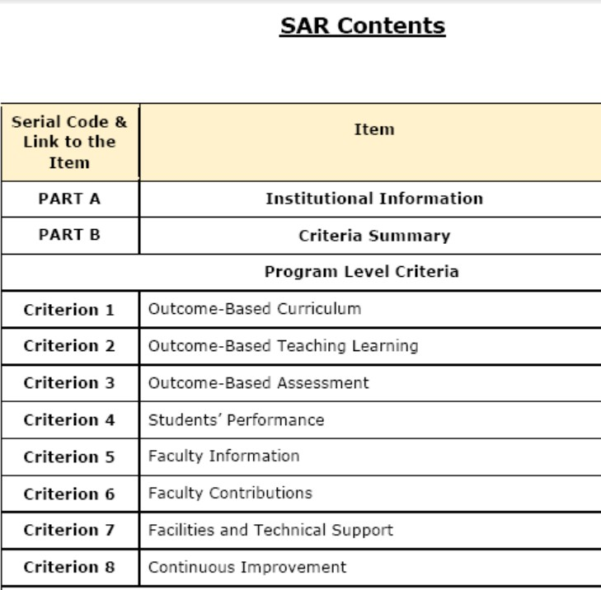
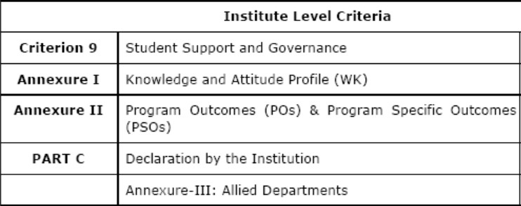

Slide 15
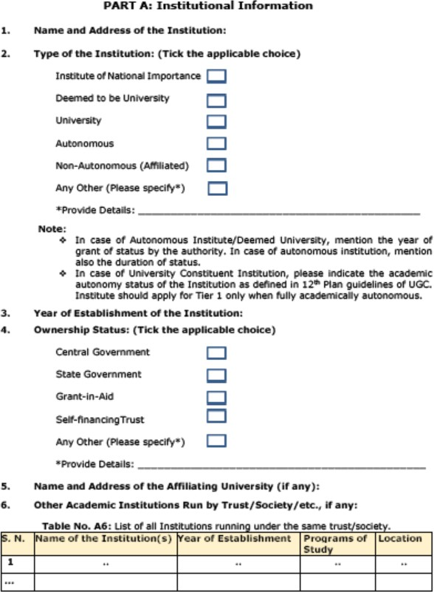

Slide 16
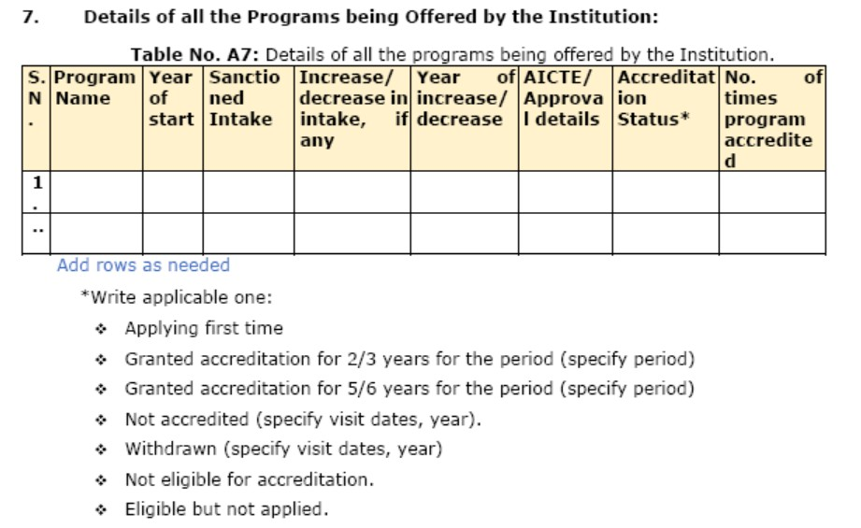

Slide 17
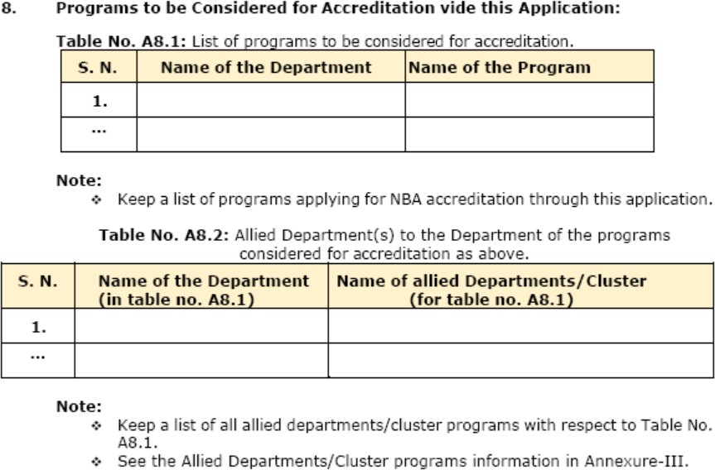

Slide 18
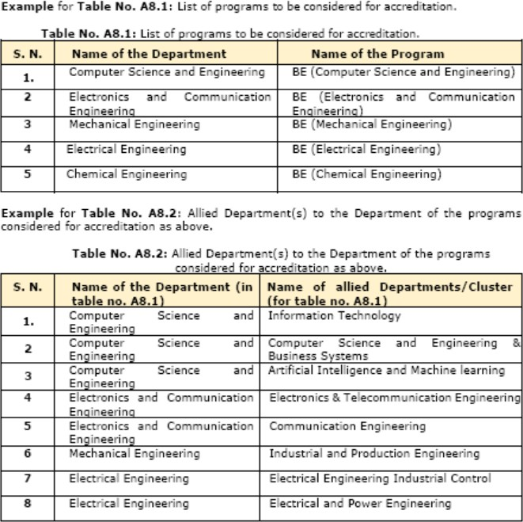

Slide 19
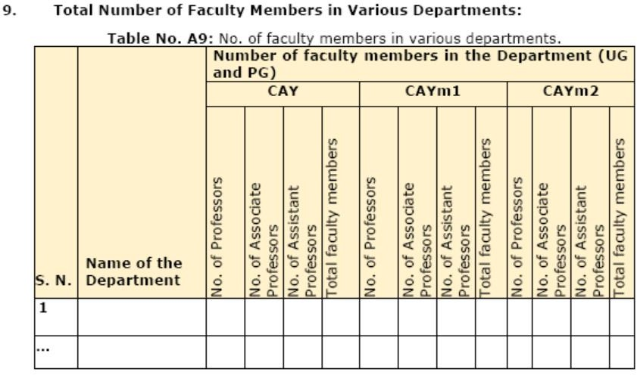

Slide 20
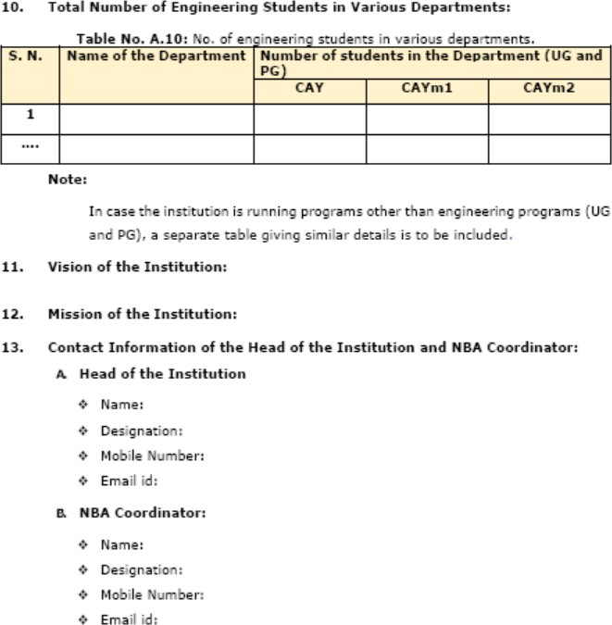

Slide 21
Continuous Quality Improvement
SAY
What you want to
Continuous Quality Improvement
DO
What you Say
Improve it
What you Proved
Prove it
What you Do

Slide 22
OBE 3 Pillars….
Curriculum
CI
Teaching,Learning
Evaluation
1

Slide 23
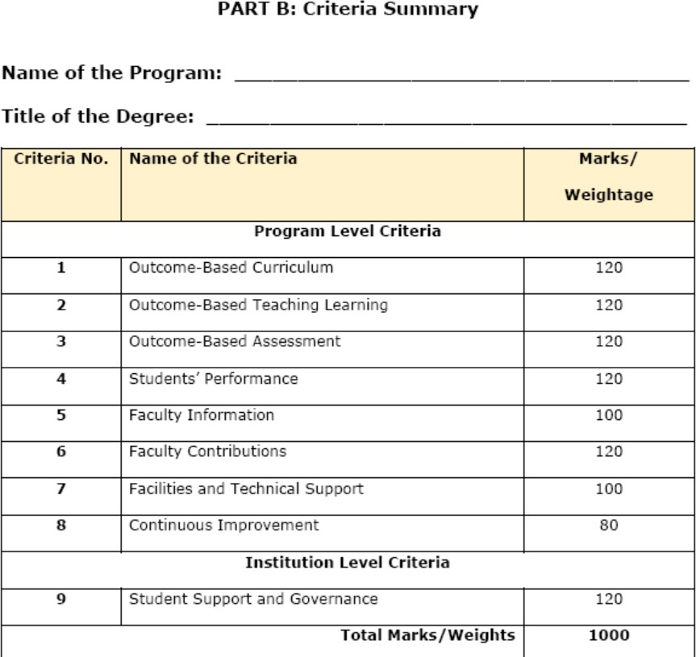

Slide 24
PART B: Program Level Criteria

Slide 25
Criterion 1: Outcome-based Curriculum (120)
Vision, Mission and Program Educational Objectives (PEOs) (35) (Provide details of vision and mission and program education objectives.)
State the Vision and Mission of the Institute and the Department (05)
(Vision statement typically indicates aspirations and Mission statement states the broad approach to achieve aspirations.)
State PEOs of the Program (05)
(State the PEOs (3 to 5) of program seeking accreditation.)

Slide 26
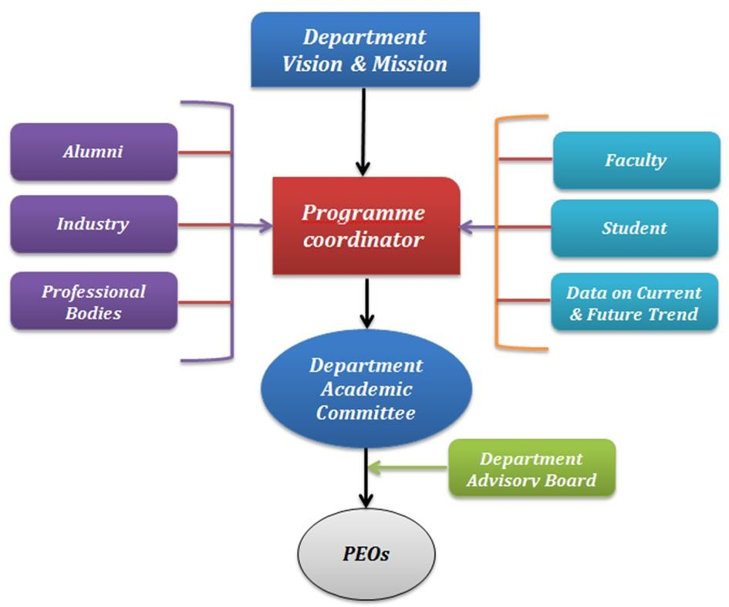
Criterion 1: Outcome-based Curriculum (120)
Process of Defining Vision, Mission and PEOs (10)
(Articulate the process involved in defining the Vision and Mission of the department and PEOs of the program.)
Dissemination of Vision, Mission and PEOs (05)
(Describe where (websites, curricula, posters etc.) the Vision, Mission and PEOs are published and detail the process which ensures awareness among internal and external stakeholders with effective process implementation.

Slide 27
Criterion 1: Outcome-based Curriculum (120)
1.1.5. Mapping of PEOs with Mission (10)
(Generate a Mission of the Department–PEOs matrix with justification and rationale of the mapping.)
Table No.1.1.5.1: Mapping of PEOs with mission
PEO Statements | M₁ | M₂ | …. | M_{n}
PEO1:
PEO2:
PEON:
Note:
M₁, M₂. . . M_{n} are distinct elements of mission statement. Enter correlation levels as
Low (1), Medium (2) and High (3). If there is no correlation, put “-”

Slide 28
Criterion 1: Outcome-based Curriculum (120)
Curriculum Structure and Features (30)
State the Process for Developing/Revising the Program Curriculum (10)
Describe the process that periodically documents and demonstrates how the program curriculum has evolved, considering the Washington Accord Knowledge and Attitude Profile (WKs) and the Program Outcomes (POs) defined by the NBA, as listed in Annexure-II.
Describe the process involving both internal and external stakeholders in framing the curriculum.)

Slide 29
Criterion 1: Outcome-based Curriculum (120)
1.229.2. Curriculum Structure (10)
(Provide details of courses in terms of teaching and learning scheme and number of credits in the Program curriculum.)
Table No.1.2.2.1: Details of various courses presented in terms of teaching and learning scheme.
Cours e Code | Course Title | Teaching & Learning Scheme
 |  | Class room Instruction (CI) (in hours per semester |  | Lab Instruction (LI) (in hours per semester | Team Work (TW) Self Leaning (SL) (TW+SL)(in hours per semester) | Total no. of Hours per semester | Total Credits (C)* (Total Hours/30)
 |  | L | T | P | SL
101 | C++ | 42 | 14 | 28 | 36 | 120 | 120/30=4
102 | Chemistry Lab |  |  | 42 | 18 | 60 | 60/30=2
…
This is as per the new National Credit Framework, which accounts for 30 hrs. of learning as equivalent to 1 credit. Those universities which are still following the LTP will transform them into no. of hours and fill in the above table.
1

Slide 30
Criterion 1: Outcome-based Curriculum (120)
1.2.3. Components of Curriculum (05)
(Provide details of Curriculum components for all relevant Years.)
Table No.1.3.3.1: Program curriculum grouping based on curriculum components.
Curriculum Component | Curriculum Content (% of total number of credits of the program) | Total number of contact hours | Total number of credits
Basic Sciences
Basic Engineering
Humanities and Social Sciences
Program Core
Program Electives
Open Electives
Project(s)
Internships/Seminars
Any other (Please specify)
₁ Total number of Credits:
Add more rows, if required

Slide 31
Criterion 1: Outcome-based Curriculum (120)
1.2.4. Strategies for Education Reforms (05)
(A brief explanation of the plans to implement and map activities in curriculum design with multidisciplinary and interdisciplinary programs, the establishment of an academic bank of credits system, APAAR etc.)
PO, PSO and their Mapping with Courses (20)
POs and PSOs (05)
(Program Specific Outcomes (PSOs) are defined by the program, with up to 3 PSOs specified.)
List of POs as Defined by NBA in Annexure II.
List of PSOs (up to 3)
(Provide details of the PSOs for the program currently seeking accreditation.)

Slide 32
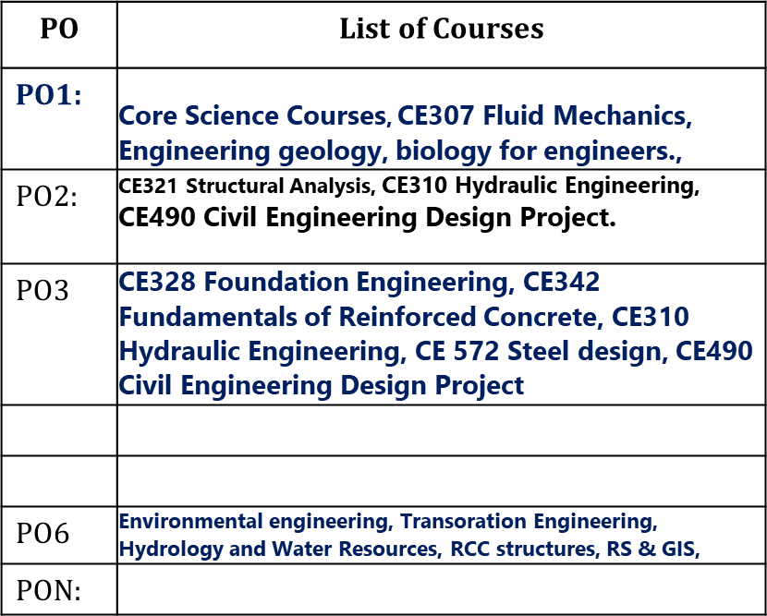
Criterion 1: Outcome-based Curriculum (120)
1.3.2. Mapping between the Courses and POs/PSOs (15)
(Mention the courses relevant to the POs/PSOs.)
Table No.1.3.1: Connection of courses with POs/PSOs.
PO Number | List of Courses
PO1:
PO2:
PON:
Add more rows for PSOs

Slide 33
Criterion 1: Outcome-based Curriculum (120)
Course Outcomes and Course Articulation Matrix (30)
Course Outcome (Semester Wise) (15)
(Provide Course outcomes (COs) for two core courses per semester from 1-8 semesters as a sample. The maximum number of outcomes for a course is expected to be around 6. COs should reflect on the measurable outcomes towards attaining POs and PSOs).
Table No. 1.4.1.1: Course outcomes.
Semester No.:
Course Title: |  | Course Code:
Course Outcome No. | Course Outcome Statement

Slide 34
Criterion 1: Outcome-based Curriculum (120)
1.³4⁴.2. Course Articulation Matrix (15)
(Provide course articulation matrices for two core courses per semester from 1- 8 semesters which have been provided in the section 1.4.1. Select courses to demonstrate the mapping/correlation with POs and PSOs.)
Table No.1.4.2: Course articulation matrix.
Course Name: Course Code:
Course Outcomes (COs) code & Statement | Program Outcomes (POs) |  |  |  |  |  |  |  |  |  |  | Program Specific Outcomes (PSOs)
 | PO -1 | PO - 2 | PO - 3 | PO - 4 | PO - 5 | PO - 6 | PO - 7 | PO - 8 | PO - 9 | PO - 10 | PO - 11 | PSO - 1 | PSO- 2
CO - 1
CO – 2
CO – 3
CO – 4
CO - 5
Add more columns for PSOs if any
Note: ❖ Enter 1correlation levels 1, 2 or 3 as defined below: ❖ 1: Slight (Low), ❖ 2: Moderate (Medium) ❖
3: Substantial (High), ❖ If there is no correlation, put “-”

Slide 35
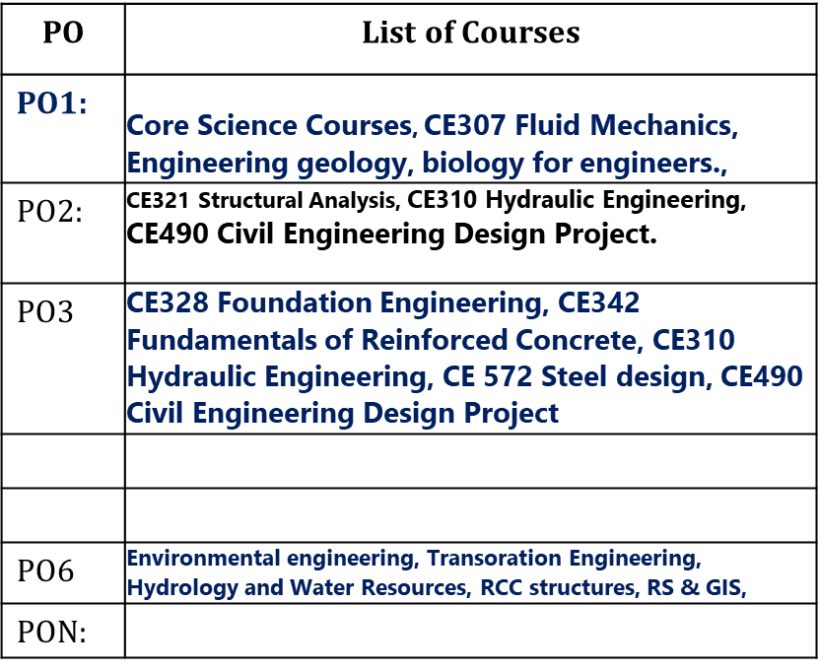
Criterion 1: Outcome-based Curriculum (120)
13.55. Program Articulation Matrix (05)
Table No.1.5.1: Program articulation matrix
Course Code | Cour se Nam e | PO-1 | PO-2 | PO-3 | PO-4 | PO-5 | PO-6 | PO-7 | PO-8 | PO-9 | PO- 10 | PO- 11
C101
C202
Fluid Mechanics
Design project
^{C4…..} Add more | column | s for PS | Os if an | y

Slide 36
Criterion 2: Outcome-Based Teaching Learning (120)
2.1. Describe Processes Followed to Ensure Quality of Teaching & Learning (20)
(Processes may include adherence to academic calendar and instruction methods using pedagogical initiatives such as real-world examples, collaborative learning, quality of laboratory experience with regard to conducting experiments, recording observations, analysis of data etc. encouraging fast learners, assisting slow learners etc. The implementation details and impact analysis need to be documented.)

Slide 37
Criterion 2: Outcome-Based Teaching Learning (120)
2.2. Quality of Student Capstone Project (25)
(Quality of the capstone/major project is measured in terms of consideration to factors including, but not limited to, environment, sustainability, safety, ethics, cost, type (application, product, research, review etc.) and standards. Processes related to project identification, allotment, continuous monitoring, evaluation including demonstration of working prototypes and enhancing the relevance of projects. Mention implementation details including details of POs and PSOs addressed through the projects with justification.)

Slide 38
Criterion 2: Outcome-Based Teaching Learning (120)
Internship/Industrial Training (10)
(Describe process, duration, POs/PSOs addressed.)
Seminar and Mini/Micro Projects (10)
(Describe process, POs/PSOs addressed.)
Case Studies and Real-Life Examples (10)
(Type and complexity, POs/PSOs addressed.)
SWAYAM/NPTEL/MOOC/Self Learning (10)
(Number of students registered, certification and POs/PSOs addressed.)

Slide 39
Criterion 2: Outcome-Based Teaching Learning
(120)
2.7. Solving Complex Engineering Sustainability Goals (20)
(Provide details of core courses (Project
Problems
Incorporating
based
learning,
problem-based
learning), mini projects, integrated design projects, capstone projects, hackathon or any other activity-based learning towards solving complex engineering problems targeting relevant SDGs.)
2.8. Steps Taken for Enhancing Industry Institute Partnerships (15)
(Provide details of partial delivery of courses, industry supported labs, industry offered short-term programs/training etc.)

Slide 40
Criterion 3: Outcome-Based Assessment (120)
Evaluation of Continuous Assessment: Assignments, Unit Tests, Mid-
Term, etc. (10)
(Describe the process of evaluation followed during continuous assessment to maintain quality of assessment; constructive alignment of questions with COs and hence POs/ PSOs. Details to be kept in course files for evaluation.)
Evaluation of the Semester End Exam (SEE) Question Paper (10) (Describe the process of setting of SEE papers & their evaluation to maintain quality of assessment, constructive alignment of questions with COs and POs/PSOs. Details to be kept in course files for evaluation.)

Slide 41
Criterion 3: Outcome-Based Assessment (120)
Evaluation of Laboratory Work and Workshop (Continuous and SEE) (10)
(Provide details of rubrics used to assess learnings in laboratories and workshops linking with COs and POs/PSOs targeted. Evidence of student assessments through rubrics to be kept in course files for evaluation.)
Evaluation of Industrial Training/Internship (Continuous and SEE) (10)
(Provide details of rubrics used to assess learnings in internships/industrial trainings linking POs/PSOs targeted for attainment. Evidence of student assessments through rubrics to be kept in course files for evaluation.)

Slide 42
Criterion 3: Outcome-Based Assessment (120)
Evaluation of Projects (20)
(Provide details of rubrics used to assess learnings in projects linking POs/PSOs targeted for attainment. Evidence of student assessments through rubrics to be kept in course files for evaluation.)
Evidence of Addressing Sustainable Development Goals (SDG) (10)
(Provide details of student work carried out to meet sustainable development goals such as research work, project work, student activities etc. Evidence in the form of a portfolio to be made available during the visit.)

Slide 43
PO2 and PO 6 : Problem Based Learning,
PO2: Problem Analysis: Identify, formulate, review research literature and analyze complex engineering problems reaching substantiated conclusions with consideration for sustainable development. (WK1 to WK4)
PO6: The Engineer and The World: Analyze and evaluate societal and environmental aspects while solving complex engineering problems for its impact on sustainability with reference to economy, health, safety, legal framework, culture and environment. (WK1, WK5, and WK7).

Slide 44
Design and Testing of a Biochar Water Filter (Env Engineering Course)
Description: Develop an environmentally friendly water filter that uses biochar, made from agricultural waste, to remove harmful contaminants from drinking water.
Inputs:
🠶 Agricultural waste (e.g., coconut shells, rice husks)
🠶 Kiln or oven for biochar production
🠶 Filtration materials (sand, gravel, biochar)
🠶 Plastic or glass containers for the filter body
🠶 Water Analysis (for pH, turbidity, microbial contamination)
Outcome:
🠶 Sustainable water purification method using locally available materials
🠶 Enhanced understanding of biochar properties and filtration efficiency
🠶 SDG Targeted: SDG 06 Clean Water and Sanitation
Reference: Dr. Prathima, CV, BMSCE.

Slide 45
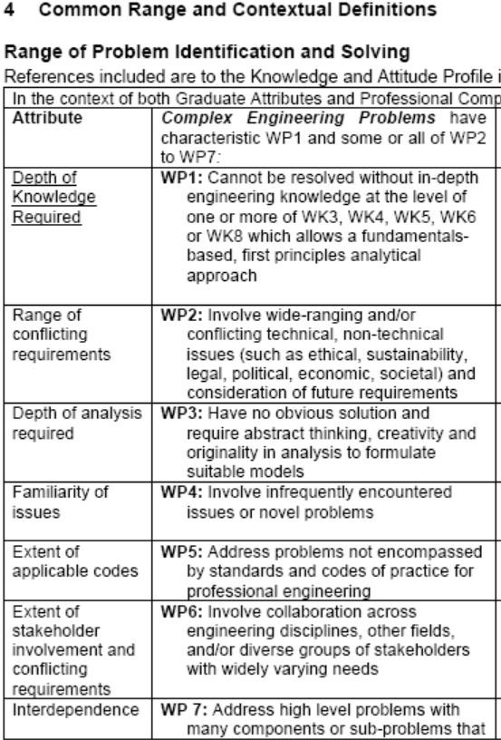
Complex Engineering Problems. (Definition)
45
may require a system approach.

Slide 46
🠶 Annexure I: Knowledge and Attitude Profile (WK)
🠶 WK1: A systematic, theory-based understanding of the natural sciences applicable to the discipline and awareness of relevant social sciences.
🠶 WK2: Conceptually-based mathematics, numerical analysis, data analysis, statistics and formal aspects of computer and information science to support detailed analysis and modelling applicable to the discipline.
🠶 WK3: A systematic, theory-based formulation of engineering fundamentals required in
the engineering discipline.
🠶 WK4: Engineering specialist knowledge that provides theoretical frameworks and bodies of knowledge for the accepted practice areas in the engineering discipline; much is at the forefront of the discipline.
🠶 WK5: Knowledge, including efficient resource use, environmental impacts, whole-life cost, re-use of resources, net zero carbon, and similar concepts, that supports engineering design and operations in a practice area.
🠶 WK6: Knowledge of engineering practice (technology) in the practice areas in the engineering discipline.
🠶 WK7: Knowledge of the role of engineering in society and identified issues in engineering practice in the discipline, such as the professional responsibility of an engineer to public safety and sustainable development.
🠶 WK8: Engagement with selected knowledge in the current research literature of the discipline, awareness of the power of critical thinking and creative approaches to evaluate emerging issues.
🠶 WK9: Ethics, inclusive behavior and conduct. Knowledge of professional ethics, responsibilities, and norms of engineering practice. Awareness of the need for diversity by reason of ethnicity, gender, age, physical ability etc. with mutual understanding and respect, and of inclusive attitudes.

Slide 47
Problem statement
Agricultural byproducts are a sustainable and easily accessible material. Biochar production from such waste is an eco-friendly method that follows the rules of the circular economy and conserves resources. Biochar may be made from agricultural byproducts such as rice husks, maize cobs, and coconut shells. This helps with waste management by lowering the amount of agricultural wastes that would otherwise be burnt or allowed to degrade, which might lead to pollution. A biochar water filter solves two environmental problems: agricultural waste management and clean drinking water. This initiative decreases pollution, promotes sustainable resource use, and improves water availability by turning agricultural leftovers into filter media. The initiative promotes sustainable development and public health via environmental engineering, sustainability, and community participation.
Design and Testing of a Biochar Water Filter
Description: Develop an environmentally friendly water filter that uses biochar, made from agricultural waste, to remove harmful contaminants from drinking water.
Scope of the Project
Create a Biochar Water Filter:
Make a water filtration system using biochar from agricultural waste to eliminate pollutants.
Encourage Sustainable Waste Management:
Show that agricultural wastes may be used to make biochar, minimizing waste and pollution.
Improve Clean Water Access: Improve rural and underserved water quality at low sustainability.
Reference: Dr. Prathima, CV, BMSCE.
cost and

Slide 48
Justification as complex engineering problem and its mapping to WK’s
WP | Justification | Targeted WK’s
 |  | WK1 | WK5 | WK7
WP1 – Depth of Knowledge required | Requires in-depth knowledge of chemical engineering (pyrolysis and adsorption), environmental science (contaminant behavior), and materials science (properties of biochar). | The project requires an understanding of chemistry (e.g., chemical reactions involved in pyrolysis), and environmental science (e.g., contaminant behavior and environmental impact). | Efficient resource reuse Pollution reduction Water quality improvement Sustainable practices Circular economy principles | The project addresses ethical considerations in providing clean water, managing agricultural waste, and ensuring environmental sustainability. It emphasizes the professional responsibility of engineers to protect public health and the environment.
WP2 – Range of conflicting requirements | Conflicts arise in balancing the efficiency of contaminant removal, the sustainability of biochar production, and the economic feasibility of the solution.
PO6: The Engineer and The World: Analyze and evaluate societal and environmental aspects while solving complex engineering problems for its impact on sustainability with reference to economy, health, safety, legal framework, culture and environment. (WK1, WK5, and WK7).

Slide 49
Criterion 3: Outcome-Based Assessment (120)
Attainment of Course Outcomes (25)
Describe the Assessment Tools and Processes Used to
Gather the Data for the Evaluation of Course Outcome (05) (Describe different assessment tools (semester end examinations, mid-semester tests, laboratory examinations, student portfolios etc.,) to measure the student learning and hence attainment of course outcomes.)
Record the Attainment of Course Outcomes of all Courses with Respect to Set Attainment Levels (20)
(Program shall set course outcome attainment levels for each course. Measuring CO attainment through Continuous Internal Examinations (CIE) and Semester End Examination (SEE) needs to be detailed.

Slide 50
Criterion 3: Outcome-Based Assessment (120)
Target may be stated in terms of percentage of students getting more than class average marks or set by the program in each of the associated COs in the assessment instruments (midterm tests, assignments, mini projects, reports and presentations etc. as mapped with the COs.))
3.8. Attainment of Program Outcomes and Program Specific Outcomes (25)
(The attainment of POs and PSOs by direct assessment based on student performance and indirect assessment based on surveys are to be presented through program level Course-PO&PSO matrices as indicated.)

Slide 51
Criterion 3: Outcome-Based Assessment (120)
PO and PSO Attainment:
Table No.3.8.1: PO and PSO attainment value using direct assessment tools.
Course | PO1 | PO2 | PO3 | PO4 | PO5 | PO6 | PO7 | PO8 | PO9 | PO10 | PO11
C101
C102
…….
C409
Direct Attainment
Add more columns as needed for PSOs if any.
Note:
C101, C102 are indicative courses in the first year. Similarly, C409 is final year course. First numeric digit indicates year of study and remaining two digits indicate course nos. in the respective year of study.
Direct attainment of a PO/PSO is determined by taking average across all courses
addressing that PO/PSO.

Slide 52
Criterion 3: Outcome-Based Assessment (120)
Table No. 3.8.2: PO and PSO attainment value using indirect assessment tools.
Name of the Survey | PO1 | PO2 | PO3 | PO4 | PO5 | PO6 | PO7 | PO8 | PO9 | PO10 | PO11
Survey-1
Survey-2
Survey-3
……..
Indirect Attainment
Add more columns as needed for PSOs if any.
Note:
Mention the type of survey conducted and the location of its source.
Indirect attainment level of a PO/PSO is determined based on the student exit surveys, employer surveys, etc.

Slide 53
Criterion 3: Outcome-Based Assessment (120)
Table No. 3.8.3: Overall PO and PSO attainment value.
Assessment | PO1 | PO2 | PO3 | PO4 | PO5 | PO6 | PO7 | PO8 | PO9 | PO10 | PO11
Direct Attainment
Indirect Attainment
Overall Attainment
Add more columns as needed for PSOs if any.

Slide 54
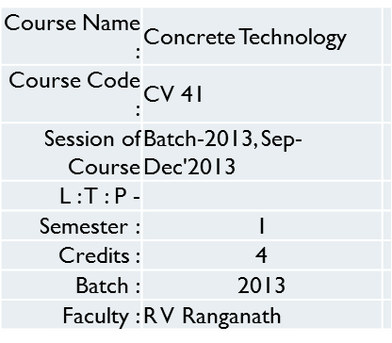
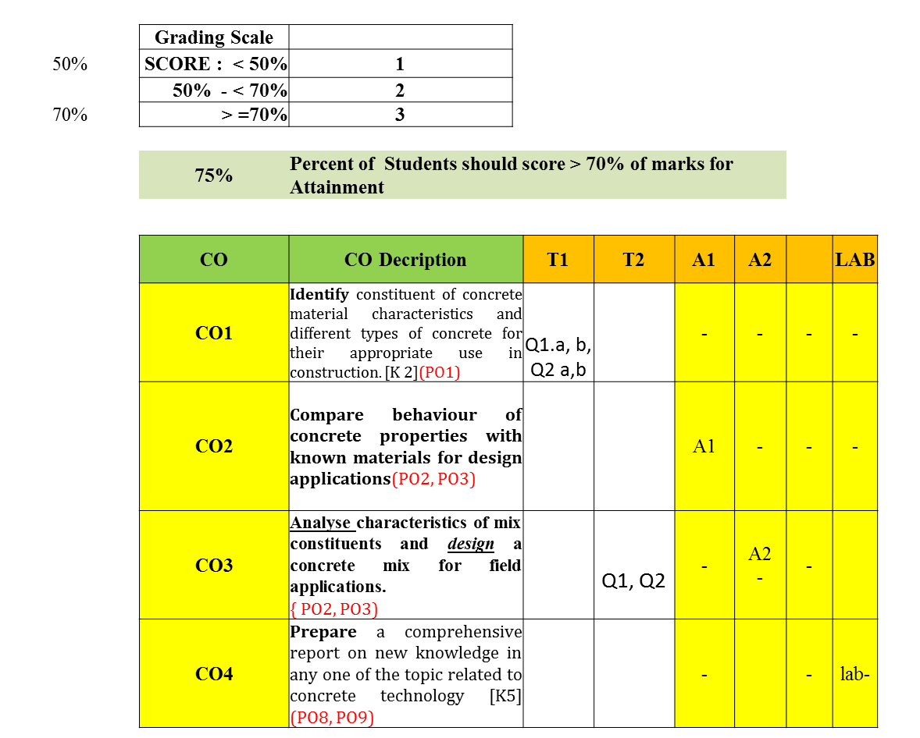
Example of CO-attainment for a course

Slide 55
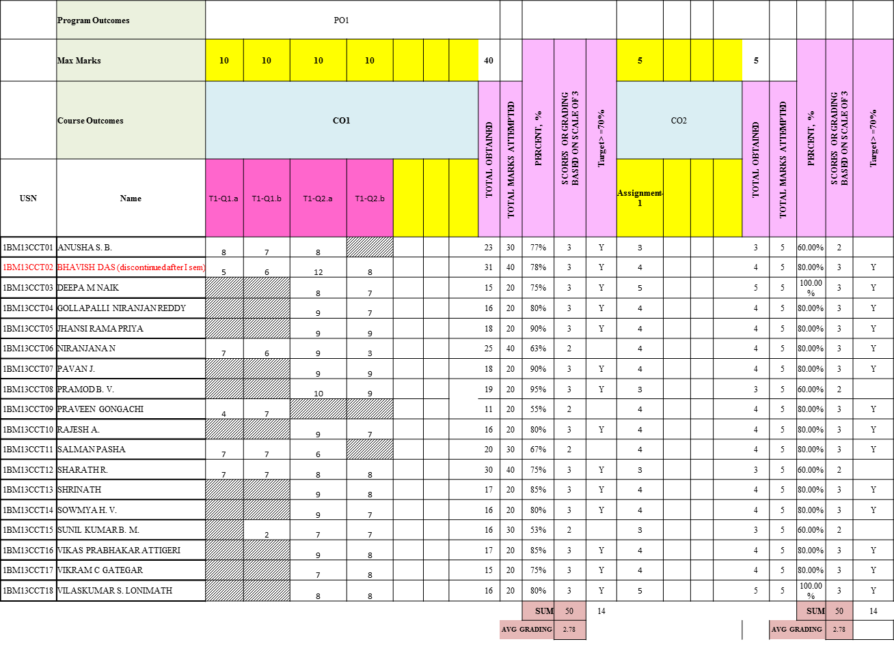
Example of CO-attainment for a course

Slide 56
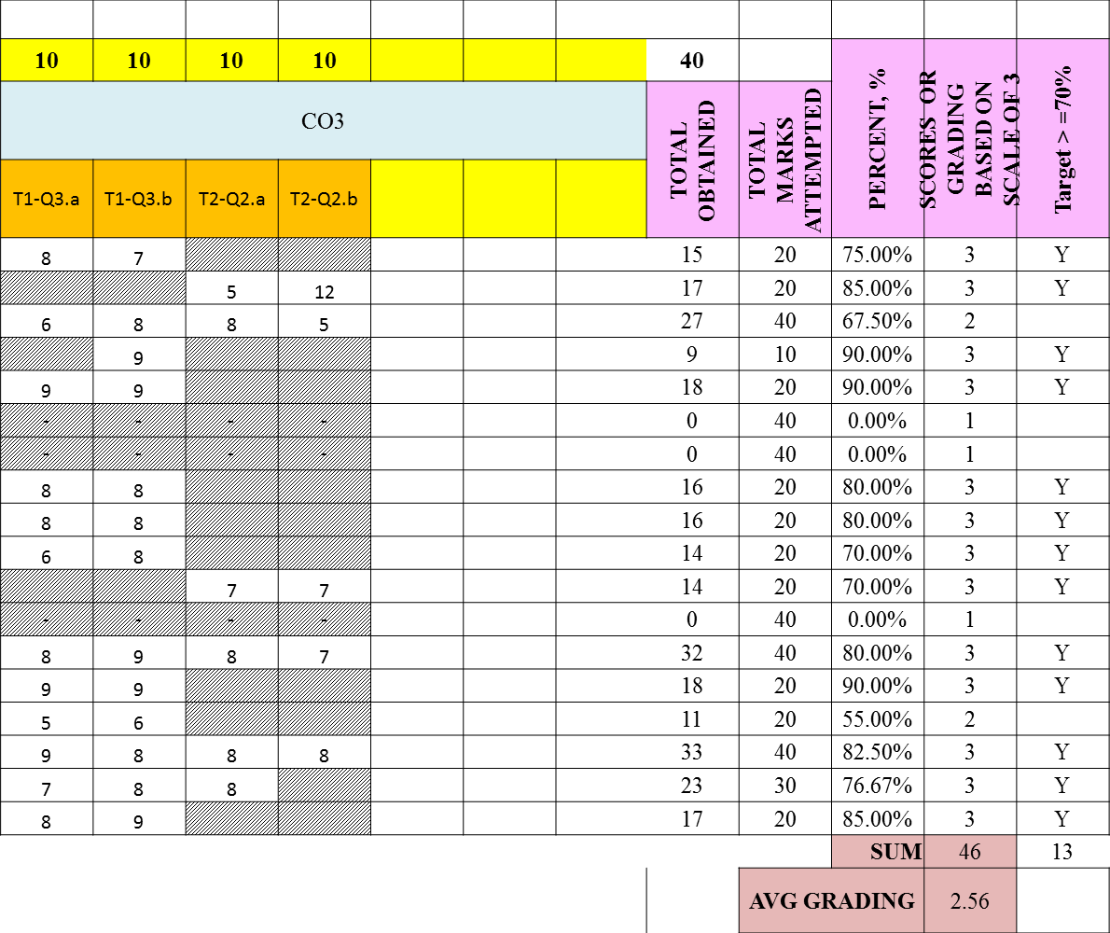
Example of CO-attainment for a course

Slide 57
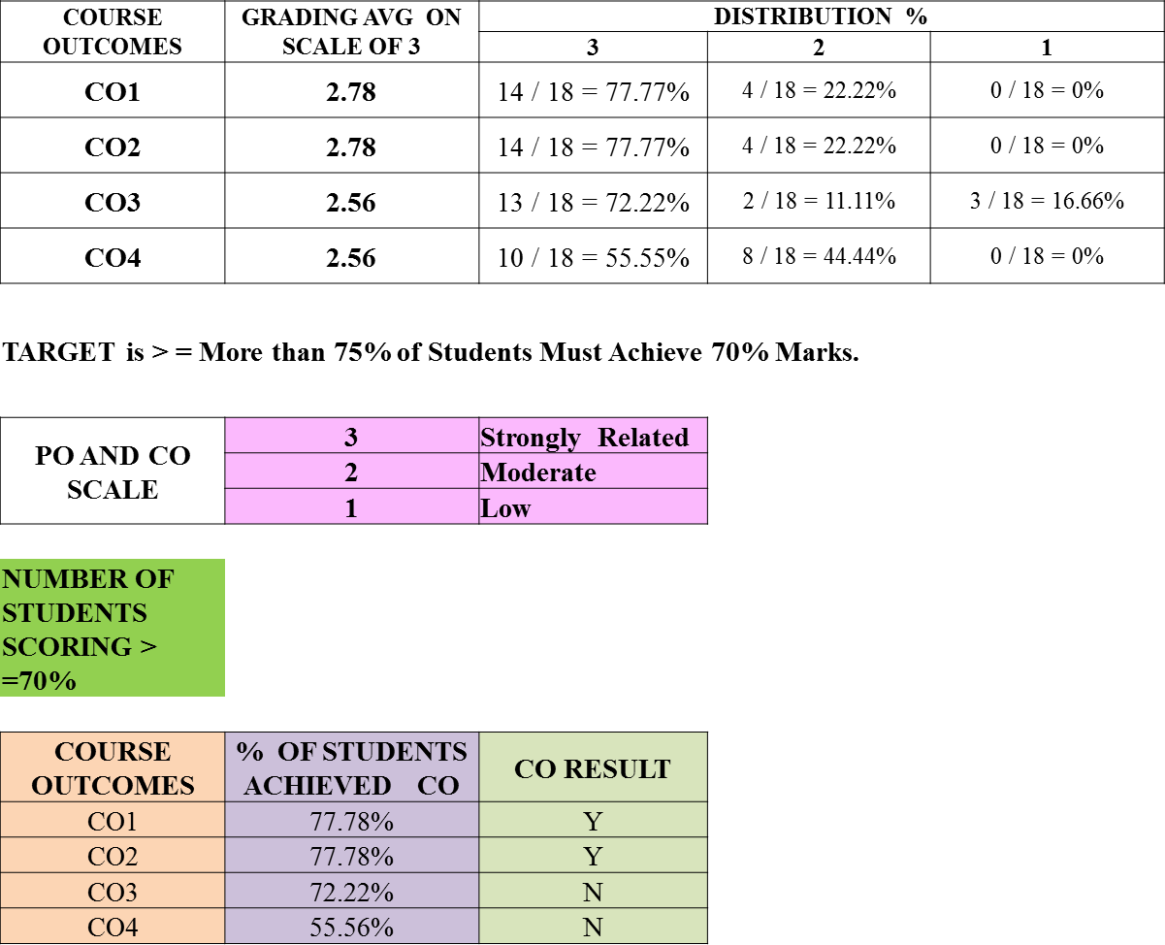
Example of CO-attainment for a course

Slide 58
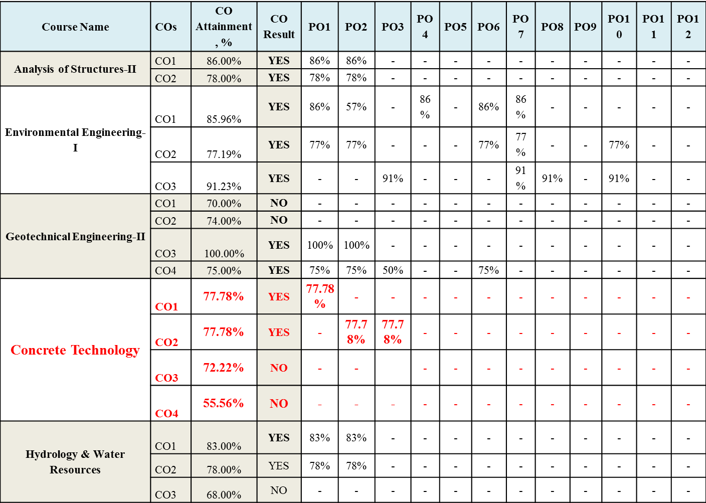
Attainment of Pos:

Slide 59
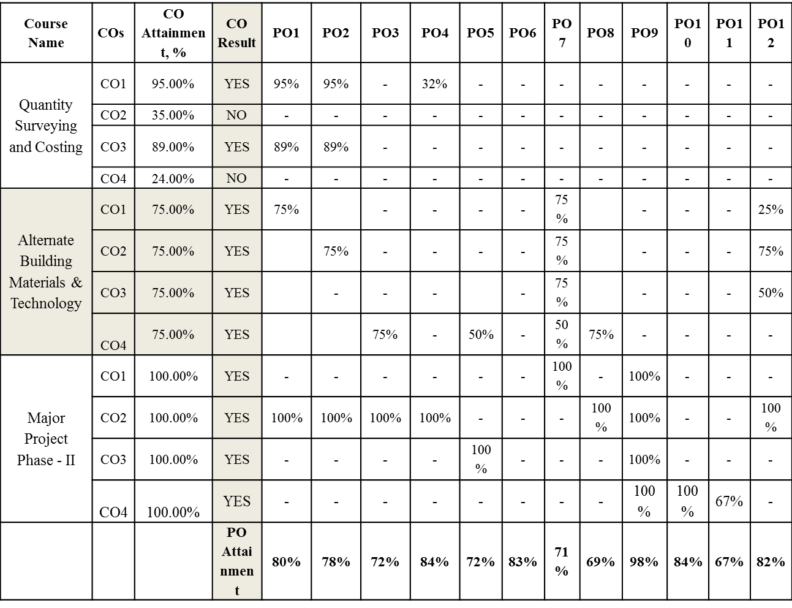
Contd…

Slide 60
Example Weightages for PO
PO No . | Attainment Method of Assessment | Dire ct Asse ssme nt (CIE ) | Direct Assess ment (SEE) | Stude nt Exit Surve y | Cours e End Surve y | Facu lty Surv ey | PO Attain ment, %
 | Weightage PO Description | 50% | 30% | 10% | 5% | 5%
PO 1 | Apply the knowledge of mathematics, science, engineering fundamentals, and an engineering specialization to the solution of complex engineering problems. | 38% | 22% | 7% | 4% | 4% | 76%
PO 2 | Identify, formulate, research literature, and analyz e complex engineering problems reaching substantiated conclusions using first principles of mathematics, natural sciences, and engineering sciences. | 37% | 22% | 7% | 4% | 4% | 75%
PO 3 | Design solutions for complex engineering problems and design system components or processes that meet the specified needs with appropriate consideration for the public health and safety, and the cultural, societal, and environmental considerations. | 32% | 23% | 7% | 3% | 3% | 68%
PO 4 | Use research based knowledge and research methods including design of experiments, analysis and interpretation of data, and synthesis of the information to provide valid conclusions. | 39% | 23% | 7% | 4% | 3% | 77%

Slide 61
PO Attainment
All POs can be adequately addressed through the
selection of core courses and their COs
Attainable targets can be selected for each of the CO.
If assessment is in alignment with COs the performance of the students indicates the CO attainment.
These measurements provide the basis for continuous improvement in the quality of learning.

Slide 62
Criterion 4: Students’ Performance (120)
Table No. 4A: Admission details for the program excluding those admitted through multiple entry and exit points.
Item (Information is to be provided cumulatively for all the shifts with explicit headings, wherever applicable) | CAY | CAY m1 | CAY m2 | CAY m3 | CAYm4 (LYG) | CAYm5 (LYGm1) | CAYm6 (LYGm2)
N= Sanctioned intake of the program (as per AICTE /Competent authority)
N1= Total no. of students admitted in the 1st year minus the no. of students, who migrated to other programs/ institutions plus no. of students, who migrated to this program
N2= Number of students admitted in 2nd year in the same batch via lateral entry including leftover seats

Slide 63
Criterion 4: Students’ Performance (120)
Item (Information is to be provided cumulatively for all the shifts with explicit headings, wherever applicable) | CAY | CAY m1 | CAY m2 | CAY m3 | CAYm4 (LYG) | CAYm5 (LYGm1) | CAYm6 (LYGm2)
N3= Separate division if any
N4= Total no. of students admitted in the 1st year via all supernumerary quotas
Total number of students admitted in the program (N1 + N2 + N3 + N4) - excluding those admitted through multiple entry and exit points.
CAY= Current Academic Year.
CAYm1= Current Academic Year Minus 1= Current Assessment Year. CAYm2= Current Academic Year Minus 2= Current Assessment Year Minus 1. LYG= Last Year Graduate.
LYGm1= Last Year Graduate Minus 1. LYGm2= Last Year Graduate Minus 2.
1

Slide 64
Criterion 4: Students’ Performance (120)
Example for Table No.4A: Admission details for the program excluding those admitted through multiple entry and exit points.
Item (Information is to be provided cumulatively for all the shifts with explicit headings, wherever applicable) | CAY 2023- 24 | CAY m1 2023- 24 | CAY m2 2023- 24 | CAY m3 2023 - 24 | CAYm4 (LYG) 2023 -24 | CAYm5 (LYGm1) 2023 -24 | CAYm6 (LYGm2) 2023-24
N= Sanctioned intake of the program (as per AICTE /Competent authority) | 120 | 120 | 120 | 120 | 120 | 120 | 120
N1= Total no. of students admitted in the 1st year minus the no. of students, who migrated to other programs/ institutions plus no. of students, who migrated to this program | 120 | 120 | 116 | 120 | 120 | 120 | 120
N2= Number of students admitted in 2nd year in the same batch via lateral entry including leftover seats | 00 | 11 | 09 | 10 | 11 | 10 | 11

Slide 65
Criterion 4: Students’ Performance (120)
Example for Table No.4A: Admission details for the program excluding those admitted through multiple entry and exit points.
Item (Information is to be provided cumulatively for all the shifts with explicit headings, wherever applicable) | CAY 2023 - 24 | CAY m1 2023 - 24 | CAY m2 2023 - 24 | CAY m3 2023 -24 | CAYm4 (LYG) 2023 - 24 | CAYm5 (LYGm1) 2023 -24 | CAYm6 (LYGm2) 2023-24
N3= Separate division if any | 00 | 00 | 00 | 00 | 00 | 00 | 00
N4= Total no. of students admitted in the 1st year via all supernumerary quotas | 00 | 00 | 00 | 00 | 00 | 00 | 00
Total number of students admitted in the program (N1 + N2 + N3 + N4) - excluding those admitted through multiple entry and exit points. | 120 | 132 | 125 | 130 | 131 | 130 | 131

Slide 66
Criterion 4: Students’ Performance (120)
Example for Table No.4B: Admission details for the program through multiple entry and exit points.
Item (No. of students admitted / exited through multiple entry and exit points) in the respective batch |  | CAY 2023 -24 | CAY m. 1 2022 -23 | CAY m2 2021 -22 | CAY m3 2020 -21 | CAYm4 (LYG) 2019 - 20 | CAYm5 (LYGm1) 2018 -19 | CAYm6 (LYGm2) 2017 -18
N5(Multiple entry) N5=N52+N5 3+N54 | N52= No. of students admitted in 2nd year via multiple entry and exit points in same batch | 0 (NA) | 2 | 1 | 2 | 1 | 1 | 2 (a)
 | N53= No. of students admitted in 3rd year via multiple entry and exit points in same batch | 0 (NA) | 0 (NA) | 0 | 0 | 0 | 0 | 1 (b)
 | N54= No. of students admitted in 4th year via multiple entry and exit points in same batch | 0 (NA) | 0 (NA) | 0 (NA) | 0 | 0 | 0 | 1 (c)
N5=N52+N53+N54 |  | 0 (NA) | 2 | 1 | 2 | 1 | 1 | 4

Slide 67
Criterion 4: Students’ Performance (120)
Example for Table No.4B: Admission details for the program through multiple entry and exit points.
Item (No. of students admitted / exited through multiple entry and exit points) in the respective batch |  | CAY 2023 -24 | CAY . m1 2022 -23 | CAY m2 2021 -22 | CAY m3 2020 - 21 | CAYm4 (LYG) 2019 - 20 | CAYm5 (LYGm1) 2018 -19 | CAYm6 (LYGm2) 2017 -18
N6 (Multiple exit) N6=N61+N 62+N63 | N61= No. of students exits after 1st year via multiple entry and exit points in same batch | 0 (NA) | 1 | 1 | 1 | 0 | 1 | 1 (d)
 | N62= No. of students exit after 2nd year via multiple entry and exit points | 0 (NA) | 0 (NA) | 0 | 0 | 0 | 0 | 1 (e)
 | N63= No. of students exit after 3rd year via multiple entry and exit points in same batch | 0 (NA) | 0 (NA) | 0 (NA) | 0 | 0 | 0 | 0 (f)
N6=N61+N62+N63 |  | 0 (NA) | 1 | 1 | 1 | 0 | 1 | 2

Slide 68
Criterion 4: Students’ Performance (120)
Example: Multiple entry for Batch LYG m2 (2017-18):
No. of students admitted through multiple entry: 4
Breakdown: 2(a) + 1(b) + 1(c), where:
a = no. of students admitted in 2nd year
b = no. of students admitted in 3rd year
c = no. of students admitted in 4th year
Therefore, for batch LYG m2 (2017-18):
2 students were admitted in the 2nd year.
1 student was admitted each in the 3rd and 4th years.

Slide 69
Criterion 4: Students’ Performance (120)
Example: Multiple exit for Batch LYG m2 (2017-18):
No. of students exiting/dropped through multiple exit: 2
Breakdown: 1(d) + 1(e) + 0(f)), where:
d = no. of students exiting after 1st year
e = no. of students exiting after 2nd year
f = no. of students exiting after 3rd year
Therefore, for batch LYG m2 (2017-18):
1 student exited after the 1st year.
1 student exited after the 2nd year.
No students exited after the 3rd year.

Slide 70
Criterion 4: Students’ Performance (120)
Table No. 4C: No. of students graduated within the stipulated period of the program.
Year of Entry | Total no. of students (N1+N2+N3+N4+N5-N6 as defined above) | Number of students who have successfully graduated in the stipulated period of study [Total of with Backlogs+ without Backlogs]
 |  | I Year | II Year | III Year | IV Year
CAY
CAYm1
CAYm2
CAYm3
CAYm4 (LYG)
CAYm5 (LYGm1)
CAYm6 (LYGm2)

Slide 71
Criterion 4: Students’ Performance (120)
Table No. 4C: No. of students graduated within the stipulated period of the program.
Year of Entry | Total no. of students (N1+N2+N3+N4+N5-N6 as defined above) | Number of students who have successfully graduated in the stipulated period of study [Total of with Backlogs+ without Backlogs]
 |  | I Year | II Year | III Year | IV Year
CAY (2023-24) | 120 (120+0+0+0+0(NA)- 0(NA)
CAYm1 (2022-23) | 133 (120+11+0+1+2-1) | 128
CAYm2 (2021-22) | 125 (116+9+0+0+1-1) | 123 | 121
CAYm3 (2020-21) | 131 (120+10+0+0+2-1) | 125 | 123 | 121
CAYm4 (LYG) (2019-20) | 132 (120+11+0+0+1-0) | 127 | 125 | 125 | 123
CAYm5(LYGm1) (2018-19) | 130 (120+10+0+0+1-1) | 125 | 123 | 122 | 121
CAYm6 (LYGm2) (2017-18) | 133 (120+11+0+0+4-2) | 129 | 127 | 126 | 124

Slide 72
Criterion 4: Students’ Performance (120)
4.1. Enrolment Ratio in the First Year (20)
ER Points= 20 * (Average ER/100)
Table No.4.1.1: Student enrolment ratio in the 1st year.
Item (Students enrolled in the First Year on average over 3 academic years (CAY, CAYm1 and CAYm2)) | CAY | CAYm1 | CAYm2
N= Sanctioned intake of the program in the 1st year (as per AICTE/Competent authority)
N1= Total no. of students admitted in the 1st year minus the no. of students, who migrated to other programs/ institutions plus no. of students, who migrated to this program
N4= Total no. of students admitted in the 1st year via all supernumerary quotas
Enrolment Ratio (ER)= (N1+N4)/N | ER_1 | ER_2 | ER_3
Average ER= (ER_1+ ER_2+ ER_3)/3

Slide 73
Criterion 4: Students’ Performance (120)
Example for Table No.4.1.1: Student enrolment ratio in the 1st year.
Item (Students enrolled in the First Year on average over 3 academic years (CAY, CAYm1 and CAYm2)) | CAY 2023-24 | CAYm1 2022-23 | CAYm2 2021-22
N= Sanctioned intake of the program in the 1st year (as per AICTE/Competent authority) | 120 | 120 | 120
N1= Total no. of students admitted in the 1st year minus the no. of students, who migrated to other programs/ institutions plus no. of students, who migrated to this program | 120 | 120 | 116
N4= Total no. of students admitted in the 1st year via all supernumerary quotas | 00 | 01 | 00
Enrolment Ratio (ER)= (N1+N4)/N | 100 | 100.83 | 96.67
Average ER= (ER_1+ ER_2+ ER_3)/3 | 99.17%

Slide 74
Criterion 4: Students’ Performance (120)
Table No. 4.1.2: The marks distribution for enrolment ratio in the 1st year.
Item (Students enrolled in the First Year on average over 3 academic years (CAY, CAYm1 and CAYm2)) | Marks
>= 90% students enrolled in the First Year on average over 3 academic years (CAY, CAYm1 and CAYm2) | 20
>= 80% students enrolled in the First Year on average over 3 academic years (CAY, CAYm1 and CAYm2) | 17
>= 70% students enrolled in the First Year on average over 3 academic years (CAY, CAYm1 and CAYm2) | 14
>= 60% students enrolled in the First Year on average over 3 academic years (CAY, CAYm1 and CAYm2) | 11
>= 50% students enrolled in the First Year on average over 3 academic years (CAY, CAYm1 and CAYm2) | 08
>= 40% students enrolled in the First Year on average over 3 academic years (CAY, CAYm1 and CAYm2) | 05

Slide 75
Criterion 4: Students’ Performance (120)
4.2. Success Rate of the Students in the Stipulated Period of the Program (15)
Success Rate (SR) = (No. of students who graduated from the program in the stipulated course duration) /(No. of students admitted in the 1st year of that batch and those actually admitted in the 2nd year via lateral entry, plus the number of students admitted through multiple entry (if any) and separate division if applicable, minus the number of students who exited through multiple entry (if any).
Average SR = Mean of SR for the past three batches.
SR Points = 1.5 * Average SR/10.

Slide 76
Criterion 4: Students’ Performance (120)
Table No.4.2.1: The success rate in the stipulated period of a program.
Item | LYG | LYGm1 | LYGm2
A*= (No. of students admitted in the 1st year of that batch and those actually admitted in the 2nd year via lateral entry, plus the number of students admitted through multiple entry (if any) and separate division if applicable, minus the number of students who exited through multiple entry (if any).
B= No. of students who graduated from the program in the stipulated course duration
Success Rate (SR)= (B/A) * 100 | SR_1 | SR_2 | SR_3
Average SR of three batches ((SR_1+ SR_2+ SR_3)/3)
Note *: If the value of A in Table No. 4.2.1 is less than the sum of the sanctioned intake (N) and the lateral entry including leftover seats (N2), then the value of A in Table No. 4.2.1 should be the sum of the sanctioned intake (N) and the lateral entry including leftover seats (N2).

Slide 77
Example:
Table No.4.2.1: The success rate in the stipulated period of a program.

Slide 78
Criterion 4: Students’ Performance (120)
4.3. Academic Performance of the First-Year Students of the Program (10)
Academic Performance = Average Academic Performance Index (API), where API = ((Mean of 1st Year Grade Point Average of all successful students on a 10-point scale) or (Mean of the percentage of marks of all successful students in 1st year/10)) * (Number of successful students/number of students appeared in the examination)
Successful students are those who have to proceeded to the 2nd year.

Slide 79
Criterion 4: Students’ Performance (120)
Table No.4.3.1: Academic Performance of the First-Year Students of the Program.
Academic Performance | CAYm1 | CAYm2 | CAYm3
X= (Mean of 1st year grade point average of all successful students on a 10-point scale) or (Mean of the percentage of marks of all successful students in 1st year/10)
Y= Total no. of successful students
Z = Total no. of students appeared in the examination
API = X* (Y/Z) | AP1 | AP2 | AP3
Average API = (AP1 + AP2 + AP3)/3

Slide 80
Criterion 4: Students’ Performance (120)
4.4 Academic Performance of the Second Year Students of the Program (10)
Academic Performance = Average Academic Performance Index (API), where
API = ((Mean of 2nd Year Grade Point Average of all successful students on a 10-point scale) or (Mean of the percentage of marks of all successful students in 2nd Year/10)) * (Number of successful students/number of students appeared in the examination).
Successful students are those who have proceeded to the 3rd year.

Slide 81
Criterion 4: Students’ Performance (120)
Table No.4.4.1: Academic Performance of the Second Year Students of the Program.
Academic Performance | CAYm1 | CAYm2 | CAYm3
X= (Mean of 2nd year grade point average of all successful students on a 10-point scale) or (Mean of the percentage of marks of all successful students in 2nd year/10)
Y= Total no. of successful students
Z = Total no. of students appeared in the examination
API = X* (Y/Z) | AP1 | AP2 | AP3
Average API = (AP1 + AP2 + AP3)/3

Slide 82
Example: Academic performance of Second -Year Students
Academic Performance | CAYm1 | CAYm2 | CAYm3
X= (Mean of 2nd year grade point average of all successful students on a 10-point scale) or (Mean of the percentage of marks of all successful students in 2rd year/10) | 5.91 | 7.70 | 7.06
Y= Total no. of successful students | 189 | 177 | 187
Z =Total no. of students appeared in the examination | 193 | 177 | 211
API = X* (Y/Z) | AP1 =5.79 | AP2 = 7.70 | AP3 = 6.26
Average API = (AP1 + AP2 + AP3)/3 | 6.58

Slide 83
Criterion 4: Students’ Performance (120)
4.5 Academic Performance of the Third Year Students of the Program (10)
Academic Performance = Average Academic Performance Index (API), where
API = ((Mean of 3rd Year Grade Point Average of all successful students on a 10-point scale) or (Mean of the percentage of marks of all successful students in 3rd Year/10)) * (Number of successful students/number of students appeared in the examination).
Successful students are those who have proceeded to the 4th year

Slide 84
Criterion 4: Students’ Performance (120)
Table No.4.5.1: Academic Performance of the Third Year Students of the Program.
Academic Performance | CAYm1 | CAYm2 | CAYm3
X= (Mean of 3rd year grade point average of all successful students on a 10-point scale) or (Mean of the percentage of marks of all successful students in 3rd year/10)
Y= Total no. of successful students
Z = Total no. of students appeared in the examination
API = X* (Y/Z) | AP1 | AP2 | AP3
Average API = (AP1 + AP2 + AP3)/3

Slide 85
Criterion 4: Students’ Performance (120)
4⁸.6⁵ Placement, Higher Studies and Entrepreneurship (30)
Placement index points= 0.3 * Average placement index (P),
Table No. 4.6.1: Placement, higher studies, and entrepreneurship details.
Item | LYG | LYGm1 | LYGm2
FS*=Total no. of final year students
X= No. of students placed
Y= No. of students admitted to higher studies
Z= No. of students taking up entrepreneurship
X + Y + Z = | P_1 | P_2 | P-3
Placement Index (P) = (((X + Y + Z)/FS) * 100)
Average placement index = (P_1 + P_2 + P_3)/3
Note *: If the value of FS in Table No. 4.6.1 is less than the sum of the sanctioned intake
(N) and the lateral entry including leftover seats (N2), then the value of FS in Table No. 4.6.1 should be the sum of the sanctioned intake (N) and the lateral entry including leftover seats (N2).

Slide 86
Criterion 4: Students’ Performance (120)
Professional Activities (25)
Professional Societies/ Bodies, Chapters, Clubs, and Professional
Engineering Events Organized (05)
(Provide a list of active professional societies/bodies, chapters, and clubs that exist at the departmental/cluster level in the past 3 years, and also provide a list of events organized by the professional societies, chapters, and clubs over the past 3 years.)

Slide 87
Criterion 4: Students’ Performance (120)
Table No. 4.7.1.1: List of active professional societies/bodies/chapters/clubs.
S.N. | Name of the Professional Societies/Bodies, Chapters, Clubs
1.
..
Table No. 4.7.1.2: List of events/programs organized.
S.N. | Name of the Professional Societies/Bodies/Chapters/Clubs | Name of the Event | National/ International level |  | Date of Event
CAYm1
1.
….
CAYm2
1.
…
CAYm3
1.
… | 1

Slide 88
Criterion 4: Students’ Performance (120)
4.7.2 Student’s Participations in Professional Events (10)
(Provide details of students, who have participated at other institutes in various professional events, such as hackathons, codeathons, ideathons, etc., over the past 3 years.)
Table No. 4.7.2.1: List of students participated in professional events.
S.N. | Name of the Students | Name of the Event | Sta. te/National/ International level | Date of Event | Name of the award if any
CAYm1
1.
….
CAYm2
1.
…
CAYm3
1.
… 1

Slide 89
Criterion 4: Students’ Performance (120)
4.7.3 Publication of Journals, Magazines, Newsletters, Department (05)
etc. in the
(Provide details of journals, magazines, newsletters, etc., published by the department, along with the names of the editors, issue numbers, volume numbers, and a list of students involved for the past 3 years.)
Table No. 4.7.3.1: List of students involved in publication of journals, magazines, and newsletters, etc. in the Department.
S.N. | Name of the Journal, Magazine, Newsletter | Name of the Editor | . Name of the Student & Semester | No. of Issues | Hard copy/ Soft copy
CAYm1
1.
….
CAYm2
1.
…
CAYm3
1.
… ₁

Slide 90
Criterion 4: Students’ Performance (120)
4.7.4 Student Publications (05)
(Provide details of student publications in journals, conferences, etc., for the past 3 years.)
Table No. 4.7.4.1: List of student publications.
S.N. | Name of the Student & Semester | Name of the Publisher |  | Name of the Journal/ Conference, etc. | Volume No. & Issue No. |  | Name of the Award if any
CAYm1
1.
….
CAYm2
1.
…
CAYm3
1.
…

Slide 91
Criterion 5: Faculty Information (100)
…. | 1. | S.N.
 |  | Name of the Faculty
 |  | PAN No.
 |  | APAAR faculty ID*(if any)
 |  | Highest degree
 |  | University
 |  | Area of Specialization
 |  | Date of Joining in this Institution
 |  | Experience in years in current institute
 |  | Designation at Time Joining in this Institution
 |  | Present Designation
 |  | The date on which Designated as Professor/ Associate Professor if any
 |  | Nature of Association (Regular/ Contract/ Ad hoc)
 |  | If contractual mention Full time or (Part time or hourly based)
 |  | Currently Associated (Y/N)
 |  | Date of Leaving if any (In case Currently Associated is “No”)
Table No. 5A: Faculty details

Slide 92
Criterion 5: Faculty Information (100)
Note
1: Please provide details of the faculty in the Department and allied Departments, including cumulative information for all three academic years starting from the current academic year (CAY) in the specified format. Programs such as MCA, BCA, and other non-engineering programs running in
the Department or allied Departments need to have sufficient faculty members to support those programs. Note that these faculty members should not be included in the above said Table no. 5A.
Note 2: All the faculty whether regular or contractual (except part-time or hourly based), will be considered. All regular faculty members shall meet the AICTE qualifications and experience requirements. The contractual faculty appointed with any terminology whatsoever, who have taught for 2 consecutive semesters with or without break between the 2 semesters in corresponding academic year on full-time basis shall be considered for the purpose of calculation in the faculty student ratio. However, following will be ensured in case of contractual faculty.

Slide 93
Criterion 5: Faculty Information (100)
Shall have the AICTE prescribed qualifications and experience.
Shall be appointed on full time basis and worked for consecutive two semesters with or without break between the 2 semesters during the particular academic year under consideration.
Should have gone through an appropriate process of selection and the records of the same shall be made available to the visiting team during NBA visit.
Note 3:
Faculty members in the Department who do not have teaching, or practical loads, will not be counted.
Director/ Principal/ Dean/ other academic/administrative posts, who has teaching/ practical load in the Department will be counted.
Visiting faculty/adjunct faculty, who are working on hourly based faculty will not be counted

Slide 94
Criterion 5: Faculty Information (100)
5.1. Student-Faculty Ratio (30)
(SFR to be calculated at Department level considering all UG and PG engineering programs in the Department; include allied department programs/clusters as well.)
No. of
UG(Engineering) programs in Department including allied
departments/clusters (UG_{n}):
UG₁=1st UG program
UG_{n}=n^{th} UG program
B= No. of Students in UG 2nd year (ST)
C= No. of Students in UG 3rd year (ST)
D= No. of Students in UG 4th year (ST)

Slide 95
Criterion 5: Faculty Information (100)
No. of PG (Engineering) programs in Department including allied departments/ clusters
(PG_{m}):
PG₁=1st PG program.
PG_{m}=m^{th} PG program
A= No. of Students in PG 1st year
B= No. of Students in PG 2nd year
Student Faculty Ratio (SFR) = S/F
S=No. of students of all programs in the Department including all students of allied departments / clusters.
No. of students (ST)=Sanctioned Intake (SA)+ Actual admitted students via lateral entry including
leftover seats (L) if any (limited to 10 % of SA)
Students who admitted under supernumerary quotas (SNQ, EWS, etc) will not be considered in calculating SFR value. Those students are exempted.
F= Total no. of regular or contractual faculty members (Full Time) in the Department, including allied departments/clusters (excluding first year faculty (The faculty members who have a 100% teaching load in the first-year courses)).

Slide 96
Criterion 5: Faculty Information (100)
96Example: Table No. 5.1.1: Calculation of no. of students admitted in the program though
lateral entry or left-over seats.
Let assume that sanctioned intake of the program (SA)=120
Example case | No. of students admitted in 1st year | Leftover seats/ Unfilled seats in 1st year | No. of actually students admitted in 2nd year, L= a+ b; a=Lateral entry admission (maximum 10% of SA) b=Leftover seats admitted in 2nd year | No. of students in the program to be considered for SFR calculation (ST) = (SA + L) limited to 110 % of SA
Case 1 | 120 | 00 | 00 | 120 (120+00)
Case 2 | 120 | 00 | 12 | 132 (120+12)
Case 3 | 120 | 00 | 06 | 126 (120+06)
Case 4 | 60 | 60 | 00 | 120 (120+00)
Case 5 | 75 | 45 | 06 | 126 (120+06)
Case 6 | 82 | 38 | 12 | 132 (120+12)
Case 7 | 88 | 32 | 44* | 132 (120+12)
Case 8 | 60 | 60 | 42* | 132 (120+12)
*Note:
If the number of students admitted in 2nd year via lateral entry including left over seats (L) is more than 10% of the sanctioned intake in the respective program, then the total number of students considered to be admitted in the program (ST) should be the sanctioned intake program plus 10% of the sanctioned intake program. Additionally, the (ST) value cannot exceed 132 in the given example.

Slide 97
Criterion 5: Faculty Information (100)
Table No. 5.1.2: Student-faculty ratio
Year | CAY | CAYm1 | CAYm2
UG₁. B
UG₁. C
UG₁. D
UG₁ | UG₁.B + UG₁.C + UG₁.D | UG₁.B + UG₁.C + UG₁.D | UG₁.B + UG₁.C + UG₁.D
……
UG_{n}. B
UG_{n}. C
UG_{n}. D
UG_{n} | UG_{n}.B + UG_{n}.C + UG_{n}.D | UG_{n}.B + UG_{n}.C + UG_{n}.D | UG_{n}.B + UG_{n}.C + UG_{n}.D

Slide 98
Criterion 5: Faculty Information (100)
Table No. 5.1.2: Student-faculty ratio
Year | CAY | CAYm1 | CAYm2
PG₁. A
PG₁. B
PG₁ | PG₁.A + PG₁.B | PG₁.A + PG₁.B | PG₁.A + PG₁.B
……
PG_{m}. A
PG_{m}. B
PG_{m} | PG_{m}.A + PG_{m}.B | PG_{m}.A + PG_{m}.B | PG_{m}.A + PG_{m}.B

Slide 99
Criterion 5: Faculty Information (100)
Table No. 5.1.2: Student-faculty ratio
Year | CAY | CAYm1 | CAYm2
DS=Total no. of students in all UG and PG programs in the Department
AS=Total no. of students of all UG and PG programs in allied departments
S=Total no. of students in the Department (DS) and allied departments (AS) | S1=UG₁ + UG₂ + .. + UG_{n} + PG₁ + …PG_{m} | S2=UG₁+UG₂+.. +UG_{n}+PG₁ + …PG_{m} | S3=UG₁+UG₂+.. +UG_{n}+PG₁ + …PG_{m}

Slide 100
Criterion 5: Faculty Information (100)
Table No. 5.1.2: Student-faculty ratio
Year | CAY | CAYm1 | CAYm2
DF=Total no. of faculty members in the Department
AF= Total no. of faculty members in the allied Departments
F=Total no. of faculty members in the Department (DF) & allied Departments (AF) | F1 | F2 | F3
FF=The faculty members in F who have a 100% teaching load in the first-year courses | FF1 | FF2 | FF3
Student Faculty Ratio (SFR)=S/(F-FF) | SFR1 = S1 / (F1-FF1) | SFR2= S2/(F2-FF2) | SFR3= S3/(F3-FF3)
Average SFR for 3 years | Average SFR=(SFR1+SFR2+SFR3)/3
Note: Programs such as MCA, BCA, and other non-engineering programs running in the Department or allied Departments need to have sufficient faculty members to support those programs. These faculty members and students should not be included in Table No. 5.1.2.

Slide 101
Criterion 5: Faculty Information (100)
Note:
Marks to be given proportionally from a maximum of 30 to a minimum of
10 for average SFR between 15:1 to 25:1, and zero for average SFR higher than 25:1. Marks distribution is given as below:
SFR < 15 - 30 Marks
< 17 - 26 Marks
< 19 - 22 Marks
< 21 - 18 Marks
< 23 - 14 Marks
< 25 - 10 Marks
25 - 00 Mark

Slide 102
Criterion 5: Faculty Information (100)
Example1: Computer Science and Engineering Department (Cluster Programs)/ (See Annexure-III):
If the College offers a cluster of Undergraduate(UG) engineering programs & Postgraduate (PG) Engineering Programs in for example Computer Science and Engineering (CSE), such as UG-Engineering-CSE, UG-Engineering-CSE (Artificial Intelligence), UG-Engineering-CSE (Artificial Intelligence and Machine Learning), UG-Engineering-CSE (Cyber Security), UG-Engineering-CSE (Data Science), UG-Engineering-Information Technology, PG-Engineering-CSE within the Department or a separate Department, they will be counted as one cluster(Department). The SFR should be calculated as follows:

Slide 103
Criterion 5: Faculty Information (100)
No. of UG ((Engineering) Programs in Department including allied departments/clusters (UG_{n}): 6
UG₁=UG-Engineering-CSE
UG₂=UG-Engineering-CSE (Artificial Intelligence)
UG₃=UG-Engineering-CSE (Artificial Intelligence and Machine Learning)
UG₄=UG-Engineering-CSE (Cyber Security)
UG₅=UG-Engineering-CSE (Data Science)
UG₆=UG-Engineering-Information Technology

Slide 104
Criterion 5: Faculty Information (100)
No. of PG ((Engineering) Programs in Department including allied departments/clusters (PG_{m}): 1
PG₁=PG-Engineering-CSE.
Let’s assume that the Department of Computer Science is offering programs
Such as UG1=UG-Engineering-CSE, UG2=UG-Engineering-CSE Intelligence), UG3=UG-Engineering-CSE (Artificial Intelligence and
(Artificial Machine
Learning), UG4=UG-Engineering-CSE (Cyber Security), UG5=UG-Engineering-CSE (Data Science), and PG1=PG-Engineering-CSE. Additionally, Allied Departments like Information Technology is offering UG6=UG-Engineering-Information Technology in the above said example. The SFR is to be calculated as follows:

Slide 105
Criterion 5: Faculty Information (100)
Example: Student-Faculty Ratio for Table No. 5.1.2.
Year | CAY | CAYm1 | CAYm2
UG₁. B | 132 | 132 | 131
UG₁. C | 132 | 131 | 130
UG₁. D | 131 | 130 | 129
UG₁ (UG-Engineering-CSE) | 395 | 393 | 390
UG₂. B | 131 | 130 | 125
UG₂. C | 130 | 125 | 130
UG₂. D | 125 | 130 | 123
UG₂ (UG-Engineering-CSE (Artificial Intelligence)) | 386 | 385 | 378

Slide 106
Criterion 5: Faculty Information (100)
Example: Student-Faculty Ratio for Table No. 5.1.2.
Year | CAY | CAYm1 | CAYm2
UG₃. B | 126 | 122 | 120
UG₃. C | 122 | 120 | 112
UG₃. D | 120 | 122 | 119
UG₃ (UG-Engineering-CSE (Artificial Intelligence and Machine Learning)) | 368 | 364 | 351
UG₄. B | 132 | 132 | 130
UG₄. C | 132 | 130 | 130
UG₄. D | 130 | 130 | 129
UG₄ (UG-Engineering-CSE (Cyber Security)) | 394 | 392 | 389

Slide 107
Criterion 5: Faculty Information (100)
Example: Student-Faculty Ratio for Table No. 5.1.2.
Year | CAY | CAYm1 | CAYm2
UG₅. B | 131 | 130 | 124
UG₅. C | 130 | 124 | 130
UG₅. D | 124 | 130 | 121
UG₅ (UG-Engineering-CSE (Data science)) | 385 | 384 | 375
UG₆. B | 132 | 131 | 130
UG₆. C | 131 | 130 | 130
UG₆. D | 130 | 130 | 128
UG₆ (UG-Engineering (Information Technology)) | 393 | 391 | 388

Slide 108
Criterion 5: Faculty Information (100)
Example: Student-Faculty Ratio for Table No. 5.1.2.
Year | CAY | CAYm1 | CAYm2
PG₁. A | 18 | 18 | 18
PG₁. B | 18 | 18 | 18
PG₁ (PG-Engineering-CSE) | 36 | 36 | 36
DS=Total no. of students in the Department (UG₁, UG₂, UG₄, UG₅, PG₁) | 1964 | 1954 | 1919
AS=Total no. of students in allied departments (UG₆) | 393 | 391 | 388
S=Total no. of students in the Department (DS) and allied departments (AS) | S1=2,357 (2,321 (all UGs) +36(PG)) | S2=2,345 (2,309(all UGs)+36(PG)) | S3=2,307 (2,271(all UGs)+36(PG))

Slide 109
Criterion 5: Faculty Information (100)
Example: Student-Faculty Ratio for Table No. 5.1.2.
Year | CAY | CAYm1 | CAYm2
DF=No. of faculty members in the Department | 95 | 99 | 100
AF=No. of faculty members in the allied Departments | 25 | 25 | 25
F=Total no. of faculty members in the Department (DF) and allied Departments (AF) | F1= 120 | F2= 124 | F3= 125
FF=The faculty members who have a 100% teaching load in the first-year courses | 00 | 00 | 00
Student Faculty Ratio (SFR)=S/(F-FF) | SFR1=2,357/120= 19.64 | SFR2=2,345/124= 18.91 | SFR3=2,307/125= 18.46
Average SFR for 3 years | Average SFR= (19.64+18.91+18.46)/3=19.00

Slide 110
Criterion 5: Faculty Information (100)
Faculty Qualification (25)
Faculty qualification index (FQI) = 2.5 * [(10X +4Y)/RF] where
X=No. of faculty members with Ph.D. degree or equivalent as per AICTE/UGC norms.
Y=No. of faculty members with M. Tech. or ME degree or equivalent as per AICTE/ UGC norms.
RF=No. of required faculty in the Department including allied Departments to adhere to the 20:1 Student-Faculty ratio, with calculations based on both student numbers and faculty requirements as per section 5.1 of SAR; (RF=S/20).

Slide 111
Criterion 5: Faculty Information (100)
Table No.5.2.1: Faculty qualification.
Year | X | Y | RF | FQI=2.5 * [(10X +4Y)/RF]
CAY
CAYm1
CAYm2
Average Assessment
Note:
To determine the RF value (No. of required faculty in the Department, including allied Departments to adhere to the 20:1 Student-Faculty ratio), all students (S as defined in section 5.1 of SAR) in the department, as well as those in allied departments, need to be considered.
The programs, such as MCA, BCA, and other non-engineering programs running in the Department or allied Departments, need to have sufficient faculty members to support those programs and exclude the faculty members and students listed in Table No. 5.2.1 (X, Y, and RF)

Slide 112
Criterion 5: Faculty Information (100)
Faculty Cadre Proportion (25)
Faculty Cadre Proportion is 1(RF1): 2(RF2): 6(RF3)
RF1=No. of Professors required = 1/9 * No. of Faculty required to comply with 20:1 Student-Faculty ratio based on no. of students (S) as per section
5.1 of SAR.
RF2= No. of Associate Professors required = 2/9 * No. of Faculty required to comply with 20:1 Student-Faculty ratio based on no. of students (S) as per section 5.1 of SAR.
RF3= No. of Assistant Professors required = 6/9 * No. of Faculty required to comply with 20:1 Student-Faculty ratio based on no. of students (S) as per section 5.1 of SAR.
Faculty cadre and qualification and experience should be as per AICTE/UGC norms.

Slide 113
Criterion 5: Faculty Information (100)
Table No.5.3.1: Faculty cadre proportion details.
Year | Professor |  | Associate Professor |  | Assistant Professor
 | Required Faculty (RF1) | Available Faculty (AF1) | Required Faculty (RF2) | Available Faculty (AF2) | Required Faculty (RF3) | Available Faculty (AF3)
CAY
CAYm1
CAYm2
Average Numbers | RF1= | AF1= | RF2= | AF2= | RF3= | AF3=

Slide 114
Criterion 5: Faculty Information (100)
If AF1 = AF2= 0, then zero mark
Maximum marks should be limited to 25 if they exceed the allocated marks
Case 1: AF1/RF1=1; AF2/RF2=1; AF3/RF3=1
Faculty Cadre Proportion marks= (1+0.6+0.4) * 12.5=25.
Case 2: AF1/RF1=1; AF2/RF2=4/2; AF3/RF3=8/9
Faculty Cadre Proportion marks=(1+1.2+0.36)* 12.5=32(limited to 25)

Slide 115
Criterion 5: Faculty Information (100)
Note:
All Professors (RF1, AF1), all Associate Professors (RF2, AF2), and all
Assistant Professors (RF3, AF3) in the department, as well as those in allied departments, should be considered for the calculation of faculty cadre proportion marks
To determine the RF1, RF2, and RF3 values, all students (S as defined in the section 5.1 of SAR) in the department, as well as those in allied departments, need to be considered.
The programs, such as MCA, BCA, and other non-engineering programs running in the Department or allied Departments, need to have sufficient faculty members to support them and exclude the faculty members listed in Table No. 5.3.1 (AF1, AF2, AF3).

Slide 116
Criterion 5: Faculty Information (100)
Visiting/Adjunct Faculty/Professor of Practice (10)
(Provide details of participation and contributions in teaching, learning, or practical work by visiting, adjunct, emeritus faculty, professors of practice, etc., from industry, research organizations & reputed institutions as well as retired professors, during the assessment period.)
Provision of visiting or adjunct faculty/emeritus professor/professor of practice etc. (1)
Minimum 50 hours per year of interaction with adjunct faculty from industry or research organization, retired professors, etc. (9)
A minimum of 50 hours of interaction in a year will result in 3 marks for that year (3 marks * 3 years = 9 marks).

Slide 117
Criterion 5: Faculty Information (100)
Table No. 5.4.1: List of visiting/adjunct faculty/professor of practice and their teaching and practical loads.
S. N. | Name of the Person | Designation & Organization | Name of the Course | No. of hours handled
CAYm1
Total no. of hours:
CAYm2
Total no. of hours:
CAYm3
Total no. of hours:

Slide 118
Criterion 5: Faculty Information (100)
5.5. Faculty Retention (10)
Table No.5.5.1: Faculty retention ratio.
Item | CAYm1 | CAYm2 | CAYm3
RF=No. of required faculty in the Department including allied Departments to adhere to the 20:1 Student-Faculty ratio, with calculations based on both student numbers and faculty requirements as per section 5.1 of SAR; (RF=S/20).
AF=The no. of available faculty members in the Department including allied Departments
A= The no. of faculty members at the current institute with less than 1 year of experience (A in AF)
B= The no. of faculty members at the current institute with more than 1 year and less than 2 years of experience (B in AF)

Slide 119
Criterion 5: Faculty Information (100)
Table No.5.5.1: Faculty retention ratio.
Item | CAYm1 | CAYm2 | CAYm3
C= The no. of faculty members at the current institute with more than 2 years and less than 3 years of experience (C in AF)
D= The no. of faculty members at the current institute with more than 3 years and less than 4 years of experience (D in AF)
E= The no. of faculty members at the current institute with more than 4 years of experience (E in AF)
FR=(((A*0)+(B*1)+(C*2)+(D*3)+(E*4))/RF) *2.50 (points limited to 10 | FR_1 | FR_2 | FR_3
Average FR= ((FR_1+ FR_2+ FR_3)/3) (marks limited to 10)

Slide 120
Criterion 5: Faculty Information (100)
Example for Table No.5.5.1: Faculty retention ratio.
Item | CAYm1 | CAYm2 | CAYm3
RF=No. of required faculty in the Department including allied Departments to adhere to the 20:1 Student-Faculty ratio, with calculations based on both student numbers and faculty requirements as per section 5.1 of SAR; (RF=S/20). | 2,357/20 =117 | 2,345/20 =117 | 2,307/20 =115
AF=The no. of available faculty members in the Department including allied Departments | 120 | 124 | 125
A= The no. of faculty members at the current institute with less than 1 year of experience (A in AF) | 1 | 0 | 2
B= The no. of faculty members at the current institute with more than 1 year and less than 2 years of experience (B in AF) | 2 | 3 | 10

Slide 121
Criterion 5: Faculty Information (100)
Example for Table No.5.5.1: Faculty retention ratio.
Item | CAYm1 | CAYm2 | CAYm3
C= The no. of faculty members at the current institute with more than 2 years and less than 3 years of experience (C in AF) | 1 | 2 | 2
D= The no. of faculty members at the current institute with more than 3 years and less than 4 years of experience (D in AF) | 1 | 0 | 1
E= The no. of faculty members at the current institute with more than 4 years of experience (E in AF) | 115 | 119 | 110
FR= (((A*0)+(B*1)+(C*2)+(D*3)+(E*4))/R F) *2.50 (points limited to 10 | FR_1= ((0+2+2+3 +460) /117) *2.50 = 9.98 | FR_2= ((0+3+4+0 +476) /117) *2.50= 10(10.32) | FR_3= ((0+10+4+ 3 + 440)/115) *2.50 = 9.93
Average FR= ((FR_1+ FR_2+ FR_3)/3) (marks limited to 10) | (9.98+10+9.93)/3=29.04/3=9.97

Slide 122
Criterion 6: Faculty Contribution (120)
Professional Development Activities (60)
Memberships in Profession Societies International Levels (05)
(Provide details of faculty members, who have
at National /
active recognized contributions to
professional memberships and their positions and professional societies during the assessment period.)
Table No. 6.1.1.1: List of faculty members and their memberships.
S. N. | Name of the Faculty | Name of the Professional Society /Body at National and International Level | Name of the Grade/ Level/Position
1 |  | ❖ ❖ | ❖ ❖
…..

Slide 123
Criterion 6: Faculty Contribution (120)
Faculty as Resource Persons or Participants in STTPs/FDPs (10)
Faculty as Resource Persons in STTPs/FDPs (05)
(Provide details of the faculty involved as resource persons in STTP/FDP events during the assessment period.)
Table No. 6.1.2.1.1: List of faculty members as resource person in STTP/FDP
S.N. | Name of the Faculty as Resource Person | Name of the STTP/FDP | Date | Location | Organized by
CAYm1
1.
…..
CAYm2
1.
…..
CAYm3
1.
…..

Slide 124
Criterion 6: Faculty Contribution (120)
Faculty Members’ Participation in STTPs/FDPs (05)
(Provide details of faculty participated in STTP/FDP events during the assessment period with special reference to the faculty competency for the program under consideration for accreditation. Please do not give duplicate data from the section 6.1.4.)
A Faculty scores maximum five points for participation
Participation in 2 to 5 days Faculty/ Faculty development program: 3 Points
Participation in >5 days Faculty/ Faculty development program: 5 points.

Slide 125
Criterion 6: Faculty Contribution (120)
Table No. 6.1.2.2.1: List of faculty members participated in STTP/FDP events.
S. N. | Name of the Faculty as Resource Person or Participant | Max. 5 per Faculty
 |  | CAYm1 | CAYm2 | CAYm3
1.
….
N
Sum
RDF=Number of faculty required to comply with the 20:1 student-faculty ratio in the Department alone, as per section 5.1 of SAR (RDF=DS/20). |  | RF_1 | RF_2 | RF_3
Assessment Points (AP)= (Sum/(0.5* RDF)) (Points limited to 5 for each assessment year) |  | AP_1 | AP_2 | AP_3
Average assessment points over 3 years= ((AP_1+AP_2+AP_3)/3) (Marks limited to 5 over the assessment period)

Slide 126
Criterion 6: Faculty Contribution (120)
Note:
We need to consider all students (DS) in the department alone to determine the RDF value (Number of faculty required to comply with the 20:1 student-faculty ratio in the Department).
Faculty members who participated in the FDP/STP programs at the parent institute will not be counted. Only participation in external programs will be considered.

Slide 127
Criterion 6: Faculty Contribution (120)
6.1.3. Faculty Contribution in Development of SWAYAM MOOCs and other E-
Content (05)
(Provide details of faculty members developed courses for various educational initiatives, including SWAYAM MOOCs/SWAYM PLUS/NPTEL, e-PG Pathshala and other e-contents during the assessment period.)
Table No. 6.1.3.1: List of faculty members developed MOOC course for the past 3 years.

Slide 128
Criterion 6: Faculty Contribution (120)
6.1.4. Faculty Certification of MOOCs through SWAYAM, etc. (10)
(Provide details of faculty members, who have obtained MOOCs (Massive Open
Online Courses) certification through platforms like SWAYAM/SWAYM PLUS/NPTEL and other approved programs during the assessment period.)
Table No. 6.1.4.1: List of faculty members obtained certification of MOOCs for the past 3 years.

Slide 129
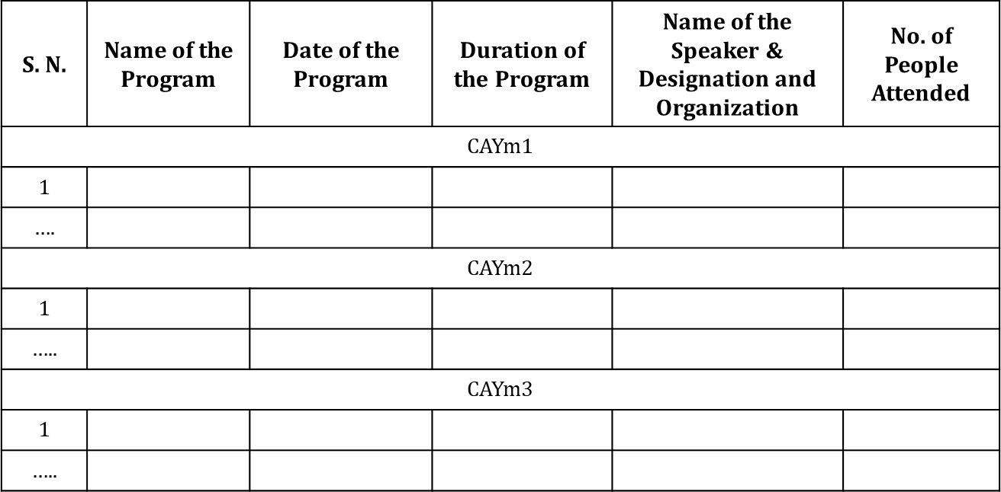
Criterion 6: Faculty Contribution (120)
6.1.5. FDP/STTP Organized by the Department (10)
(Provide details of the number of faculty development programs and short-term training
programs organized by the department individually or in collaboration with other departments over the past 3 years.)
The minimum duration of FDP/STTP is 5 days.
2 points per FDP/STTP, with a maximum of 4 marks per assessment year and a total maximum of 10 marks

Slide 130
Criterion 6: Faculty Contribution (120)
6.1.6. Faculty Support in Student Innovative Projects (10)
(Provide details of faculty supports as a mentor, facilitator, etc. in student innovation projects in various events like hackathons, codeathons, ideathons, open research, etc.)
Table No. 6.1.5.1: List of FDPs/STPs organized by Department for the past 3 years.
S. N. | Name of the Faculty | Name of the Event | Date of Event | Place of Event | Website link, if any
CAYm1
1
….
CAYm2
1
…..
CAYm3
1
…..

Slide 131
Criterion 6: Faculty Contribution (120)
6.1.7. Faculty Internship/Training/Collaboration with Industry (10) (Provide details of faculty members who have undergone internships or training in industry and research organizations, or a list of faculty members who are actively collaborating with industry.
(The outcomes of internships, training, and collaborations including the number of programs organized for students and faculty members, the development of working models and prototypes, the publication of joint research papers, the number of funded projects received, etc. for the assessment period.)

Slide 132
Criterion 6: Faculty Contribution (120)
Research and Development Activities (60)
Academic Research (10)
(Provide details of compiled list including research papers, available online or in hard-copy, from reputable publishers and should be list of Scopus/WoS. Only papers with the faculty member's affiliation aligned with the current institution are considered. Each entry in the comprehensive list includes details such as DOI, publisher, and month/year of publication).

Slide 133
Criterion 6: Faculty Contribution (120)
Table No. 6.2.1.1: Faculty publication details.
S.N. | Item | CAYm1 | CAYm2 | CAYm3
1 | No. of peer reviewed journal papers published
2 | No. of peer reviewed conference papers published
3 | No. of books/book chapters published
6.2.2. Ph.D. Student Details (05)
(No. of Ph.D. students’ enrollment and graduated in the Department during the assessment period.)
S.N. | Item | CAYm1 | CAYm2 | CAYm3
1 | No. of students enrolled for Ph.D. in the Department
2 | No. of Ph.D. students graduated in the Department

Slide 134
Criterion 6: Faculty Contribution (120)
Development Activities (10)
(Provide details of patents granted/published, working models, and
prototypes developed by faculty members in the last 3 years.)
Sponsored Research Project (15)
(Provide details of funded research projects from the external sources including Corporate Social Responsibility (CSR). List includes Principal Investigator (PI), Co-PI name, name of the dept where project is sanctioned, project title, funding agency, sanctioned amount, duration and sanctioned year. Also, provide the cumulative funding amount received during CAYm1, CAYm2, and CAYm3. Please do not give duplicate data from the sections 6.2.5 and 6.2.6.)

Slide 135
Criterion 6: Faculty Contribution (120)
Amount >20 Lacs – 15 Marks
Amount >16 Lacs and < 20 lacs– 12 Marks
Amount >12 Lacs and < 16 lacs –9 Marks
Amount > 8 Lacs and < 12 lacs –6 Marks
Amount > 4 Lacs and < 8 lacs –3 Marks
Amount > 1 Lacs and < 4 lacs –1 Mark
Amount < 1 Lac – 0 Mark.

Slide 136
Criterion 6: Faculty Contribution (120)
Table No. 6.2.4.1: List of sponsored research projects received from external agencies.
S.N. | PI name | Co-PI names if any | Name of the Dept., where project is sanctioned |  | Project title* |  | Name of the Funding agency | Duration of the project | Amount (Lacs)
CAYm1
1
….
Amount received (Rs)
CAYm2
1
…..
Amount received (Rs)
CAYm3
1
…..
Amount received (Rs)
Total Amount (Lacs) Received for the Past 3 Years

Slide 137
Criterion 6: Faculty Contribution (120)
Note*:
Only sponsored research projects will be considered. Infrastructure-based projects will
not be considered here.
6.2.5. Consultancy Work (15)
(Provide details of consultancy projects from the external sources. List includes Principal
Investigator (PI), Co-PI name, name of the dept where project is sanctioned, project title, funding agency, sanctioned amount, duration and sanctioned year. Also, provide the cumulative funding amount received during CAYm1, CAYm2, and CAYm3. Please do not give duplicate data from the sections 6.2.4 and 6.2.6.)
Amount >20 Lacs – 15 Marks
Amount >16 Lacs and < 20 lacs–12 Marks
Amount >12 Lacs and < 16 lacs –9 Marks
Amount > 8 Lacs and < 12 lacs –6 Marks
Amount > 4 Lacs and <8 lacs –3 Marks
Amount > 1 Lacs and <4 lacs –1 Mark
Amount < 1 Lac – 0 Mark.

Slide 138
Criterion 6: Faculty Contribution (120)
Table No. 6.2.5.1: List of consultancy projects received from external agencies.
S.N. | PI name | Co-PI names if any | Name of the Dept., where project is sanctioned |  | Project title* |  | Name of the Funding agency | Duration of the project | Amount (Lacs)
CAYm1
1
….
Amount received (Rs)
CAYm2
1
…..
Amount received (Rs)
CAYm3
1
…..
Amount received (Rs)
_{ote*:} Total Amount (Lacs) Received for the Past 3 Years
N
Only consultancy projects will be considered. Infrastructure-based projects will not be considered here.

Slide 139
Criterion 6: Faculty Contribution (120)
6.2.6. Institution Seed Money or Internal Research Grant to its
Faculty for Research Work (05)
(Provide details of faculty members received Institution seed money grants to its faculty for research work. Also, provide the cumulative funding amount received and utilized during CAYm1, CAYm2, and CAYm3. Please do not give duplicate data from the sections 6.2.4 and 6.2.5. The outcomes of the project are no. of publications, no. of working models/prototypes, no. of Ph.D. students graduated, no. of M.E students graduated, amount generated, etc.)

Slide 140
Criterion 6: Faculty Contribution (120)
Amount received (3 marks)
Amount > 6 Lacs – 3 Marks
Amount > 4 Lacs and < 6 lacs– 2 Marks
Amount > 2 Lacs and < 4 lacs – 1 Mark
Amount < 1 Lac – 0 Mark. Amount utilized (2 marks).

Slide 141
Criterion 6: Faculty Contribution (120)
Table No. 6.2.6.1: List of faculty members received seed money or internal research grant from the institution.
S.N. | Faculty name | Project title/ support for activity | Duration | Amount (Lacs) | Amount Utilised | Outcome of the project
CAYm1
1
….
Amount received (Rs)
CAYm2
1
…..
Amount received (Rs)
CAYm3
1
…..
Amount received (Rs)
Total Amount (Lacs) Received for the Past 3 Years

Slide 142
Criterion 7: Facilities and Technical Support (100)
7.1. Adequate and Well-Equipped Laboratories, and Technical Manpower (40)
(Provide details of various laboratories for the program and at the department level. Also, please provide a list of technical support staff appointed by the College for the Department and their qualifications. Please do not give duplicate data from the sections 7.2 and 7.5.)

Slide 143
Criterion 7: Facilities and Technical Support (100)
Table No.7.1.1: List of laboratories and technical manpower.
S. N. | Name of the Laboratory | No. of students per setup (Batch Size) | Name of the major equipment | Weekly utilization status (all the courses for which the lab is utilized) | Technical Manpower support
 |  |  |  |  | Name of the technical staff | Name of the technical staff | Qualification
1.
….
N.

Slide 144
Criterion 7: Facilities and Technical Support (100)
7.2. Additional Facilities Created for Improving the Quality of Learning Experience in Laboratories (20)
(Provide details of various additional facilities provided by the department to enhance the quality of learning in laboratories. Please do not give duplicate data from the sections 7.1 and 7.5.)
Table No.7.2.1: List of additional facilities.
S. N. | Name of the Facility | Details | Purpose for creating facility | Utilization | Relevance to Pos/PSOs
1.
….
N.

Slide 145
Criterion 7: Facilities and Technical Support (100)
7.3. Maintenance of Laboratories and Overall Ambiance (10)
(Provide details of overall laboratories maintenance and overall ambiance in the Department.)
7.4. Safety Measures in Laboratories (10) (Provide details of various safety measures laboratory within the Department.)
deployed in each

Slide 146
Criterion 7: Facilities and Technical Support (100)
Table No. 7.4.1: List of various safety measures in laboratories.
S. N. | Name of the Laboratory | Safety measure
1.
….
N.
7.5. Project Laboratory / Research Laboratory / Centre of Excellence (20)
(Provide details of laboratories for supporting projects, research, Centre of Excellence, innovation, and startups etc. Please do not give duplicate data from the sections 7.1 and 7.2.)

Slide 147
Criterion 8: Continuous Improvement (80)
8. 1. Actions Taken Based on the Results of Evaluation of the COs, POs, and PSOs (40)
8.1.1. Actions Taken Based on the Results of Evaluation of the COs Attainment (20)
(Identify the areas of weaknesses in the program based on the analysis of evaluation of COs attainment levels. Measures identified and implemented to improve COs attainment levels for the assessment year (CAYm1) including curriculum intervention, pedagogical initiatives, support system improvements, etc.)

Slide 148
Criterion 8: Continuous Improvement (80)
8.1.2. Actions Taken Based on the Results of Evaluation of the
POs/PSOs Attainment (20)
(Identify the areas of weaknesses in the program based on the analysis of evaluation of POs/PSOs attainment levels. Measures identified and implemented during two years to improve POs attainment levels including curriculum intervention, pedagogical initiatives, support system improvements, etc.)
8.2. Academic Audit and Actions Taken thereof during the Period of Assessment (15)
(Academic audit system/process and its implementation in relation to continuous improvement.)

Slide 149
Criterion 8: Continuous Improvement (80)
8.3. Improvement in Faculty Qualification/Contribution (15) (Assessment is based on improvement in qualification and publications with respect to the Department)
Table No.8.3.1: Improvement in qualification and publications
Item | CAYm1 | CAYm2 | CAYm3
No. of faculty members with Ph.D. degree
No. of publications in peer reviewed journals
No. of publications in conferences

Slide 150
Criterion 8: Continuous Improvement (80)
8.4. Improvement in Academic Performance (10)
(Provide details of improvement in academic performance of 1st year, 2nd year, 3rd year students during the assessment period.)
Table No.8.4.1: Improvement in academic performance
Item | CAYm1 | CAYm2 | CAYm3
Academic Performance Index (API) of the First-Year Students in the Program (Refer to section 4.3)
Academic Performance Index of the Second-Year Students in the Program (Refer to section 4.4)
Academic Performance Index of the Third Year Students in the Program (Refer to section 4.5)

Slide 151
Criterion 9: Student Support System and Governance (120)
9.1. First Year Student-Faculty Ratio (FYSFR) (05)
(Data for first year courses to calculate the FYSFR)
Table No. 9.1.1: FYSFR details.
Year | Sanctioned intake of all UG programs (S4) | No. of required faculty (RF4= S4/20) | No. of faculty members in Basic Science Courses & Humanities and Social Sciences including Management courses (NS1) | No. of faculty members in Engineering Science Courses (NS2) | Percentage= No. of faculty members ((NS1*0.7) +(NS2*0.3))/(No. of required faculty (RF4)); Percentage=((NS1*0.7)+ (NS2*0.3))/RF4
CAY | 300 | 15 | 18 | 3 | ((18*0.7) +(3*0.3))/15 =(12.6+0.9)/15=13.5/15=90%
CAYm1 | 300 | 15 | 16 | 2 | ((16*0.7) +(2*0.3))/15 =(11.2+0.6)/15=10.4/15=78.67%
CAYm2 | 240 | 12 | 10 | 2 | ((10*0.7) +(2*0.3))/12 =(7+0.6)/12=7.6/12=56.63%
Average Percentage |  |  |  |  | 75.1

Slide 152
Criterion 9: Student Support System and Governance (120)
Note:
Ex: If S4=240, the Institute needs a minimum of 2 faculty members in Physics, 2 in
Chemistry, and 4 in Mathematics.
Ex: If S4=420, the Institute needs a minimum of 4 faculty members in Physics, 4 in Chemistry, and 5 in Mathematics.
Ex: If S4=720, the Institute needs a minimum of 6 faculty members in Physics, 6 in Chemistry, and 8 in Mathematics.

Slide 153
Criterion 9: Student Support System and Governance (120)
For intake(S4) more than 720, an FYSFR of 1:20 shall be maintained approximately.
90% of faculty members;
80% to < 90 of faculty members;
70% to < 80 of faculty members;
60% to < 70 of faculty members;
50% to < 60 of faculty members;
< 50% of faculty members;
05 marks.
04 marks.
03 marks.
02 marks.
01 mark.
00 mark.

Slide 154
Criterion 9: Student Support System and Governance (120)
9.2. Mentoring System (05)
(Type of mentoring: Professional guidance/career advancement/course work specific/laboratory specific/all-round development. Number of faculty mentors: Number of students per mentor: Frequency of meeting:
The institution should report the details of the mentoring system, its implementation and effectiveness through impact studies, services both online and physical, and the mentoring of seniors (final year students) to juniors (freshmen) if any, etc.).

Slide 155
Criterion 9: Student Support System and Governance (120)
Feedback Analysis (10)
Feedback on Teaching and Learning Process and Corrective Measures Taken, if any (05)
(Provide details of the feedback collection process on TLP, average percentage of students who participate; Specify the feedback analysis process; Basis of reward/ corrective measures during the assessment period. Specify the number of corrective measures taken. Exhibit the details of analysis done.)
Feedback on Academic Facilities (05)
(Provide details of the feedback collection process on facilities, its analysis and corrective actions taken during the assessment period.)

Slide 156
Criterion 9: Student Support System and Governance (120)
Training and Placement Support (10)
(Provide details of the training and placement supports, calendar of scheduled trainings, career guidance and effectiveness of career guidance, industry interaction exclusively for pre-placement/internship/placement
/counseling and support for higher study etc.)
Start-up and Entrepreneurship Activities (05)
(Describe the initiatives, facilities created/utilization and their effectiveness in encouraging students for innovation, entrepreneurship, incubation and start-up. Also provide the list of beneficiaries.)

Slide 157
Criterion 9: Student Support System and Governance (120)
Governance and Transparency (25)
Availability of the Institutional Strategic Plan and its Effective
Implementation and Monitoring (10)
(Provide details of the Institute's strategic plan or Institutional Development Plan (IDP), its approval by the competent authority, and its implementation.)

Slide 158
Criterion 9: Student Support System and Governance (120)
9.6.2. Governing Body, Administrative Setup, Functions of Various Bodies, Service Rules, Recruitment procedures and Promotion Policies (10)
(Provide details of statutory and non-statutory administrative committees like the Governing body, Academic Council/ Senate, Grievance redressal Committee, IQAC, Anti-Raging committee, Disciplinary committee in place; Internal Complaints Committee (Women harassment mitigation committee) etc., provide the approval of these committees along with details of members, the meetings details (meeting notice, agenda, minutes, action taken etc. The service rules, policies and procedures; year of publication are to be listed.)

Slide 159
Criterion 9: Student Support System and Governance (120)
9.6.3. Transparency (05)
(Information on policies, rules, processes, delegation of financial powers, faculty, students, etc., and dissemination of this information to stakeholders should be made available on the Institute's website. Agendas and minutes of the Governing Body, Academic Council, and Senate are also required to be uploaded on the Institute's website. Additionally, state the extent of awareness among the stakeholders.)

Slide 160
Criterion 9: Student Support System and Governance (120)
9.7. Budget Allocation, Utilization, and Public Accounting at Institute Level (12)
(Provide a summary of the financial year's budget and actual expenditure incurred exclusively for the institution in the three financial years: CFYm1, CFYm2, and CFYm3. If the management oversees multiple Institutions, exclusive audited records for each Institute must be provided and made available on the Institute's website. The budget should be approved by the Institute BoG/GB/GC before the start of the financial year.)
CFY=Current Financial Year. CFYm1=Current Financial Year Minus 1. CFYm2=Current Financial Year Minus 2. CFYm3=Current Financial Year Minus 3.

Slide 161
Criterion 9: Student Support System and Governance (120)
For CFYm1
Table No. 9.7.1: Summary of budget and actual expenditure incurred at Institute level for CFY m1.
Total Income in the CFYm1 |  |  |  | Actual expenditure in the CFYm1 | Total Students in the institute | Expenditure per student in CFYm1:
Fee | Govt. | Grants | Other Sources (specify)
Note:
Similar tables are to be prepared for CFYm2 & CFYm3.
Audited statements for CFYm2, and CFYm3 are to be uploaded on the website

Slide 162
Criterion 9: Student Support System and Governance (120)
Table No. 9.7.2: Budget and actual expenditure incurred at Institute level.
Items | Budge ted in CFY | Actual expenses in CFY (till …) | Budget ed in CFYm1 | Actual Expenses in CFYm1 | Budget ed in CFYm2 | Actual Expens es in CFYm2 | Budgeted in CFYm3 | Actual Expenses in CFYm3
Infrastructure Built-Up
Library
Laboratory equipment
Teaching and non-teaching staff salary
Outreach Programs
R&D

Slide 163
Criterion 9: Student Support System and Governance (120)
Table No. 9.7.2: Budget and actual expenditure incurred at Institute level.
Items | Budget ed in CFY | Actual expenses in CFY (till …) | Budget ed in CFYm1 | Actual Expenses in CFYm1 | Budget ed in CFYm2 | Actual Expense s in CFYm2 | Budget ed in CFYm3 | Actual Expenses in CFYm3
Training, Placement and Industry linkage
SDGs
Entrepreneurship
Others*, pl. specify
Total amount
* Items to be mentioned.

Slide 164
Criterion 9: Student Support System and Governance (120)
9.8. Program Specific Budget Allocation, Utilization (08) (Total budget at program level: CFYm1, CFYm2 & CFYm3 CFY=Current Financial Year.
CFYm1=Current Financial Year Minus 1. CFYm2=Current Financial Year Minus 2. CFYm3=Current Financial Year Minus 3.)
For CFYm1 (Similar table to be prepared for CFYm2 and CFYm3)
Table No. 9.8.1: Summary of budget and actual expenditure incurred at program level.
Total Budget in CFYm1: |  | Actual expenditure in CFYm1: |  | Total No. of students in CFYm1:
Demanded | Actual Allocated | Actual Expenditure | % Spent | Expenditure per student
Note: Justification and process of budgeting to be listed.

Slide 165
Criterion 9: Student Support System and Governance (120)
Table No. 9.8.2: Budget and actual expenditure incurred at program level.
Items | Budget ed in CFY | Actual expenses in CFY (till …) | Budget ed in CFYm1 | Actual Expenses in CFYm1 | Budget ed in CFYm2 | Actual Expens es in CFYm2 | Budget ed in CFYm3 | Actual Expenses in CFYm3
Laboratory equipment
Software
SDGs
Support for faculty development
R&D

Slide 166
Criterion 9: Student Support System and Governance (120)
Table No. 9.8.2: Budget and actual expenditure incurred at program level.
Items | Budget ed in CFY | Actual expenses in CFY (till …) | Budget ed in CFYm1 | Actual Expenses in CFYm1 | Budgete d in CFYm2 | Actual Expense s in CFYm2 | Budgete d in CFYm3 | Actual Expenses in CFYm3
Industrial Training, Industry expert, Internship
Miscellaneous expenses *
Total amount
* Items to be mentioned.

Slide 167
Criterion 9: Student Support System and Governance (120)
Quality of Learning Resources (Hard/Soft) (05)
(Provide details of available learning resources, including e-resources (books
and journals), as well as information on the accessibility of these resources to students. Additionally, describe the support provided to students for self- learning activities.)
E-Governance (05)
(E-governance initiatives, sustainable practices in academic and learning management, campus-wide computing resources, and their accessibility and availability to support academic and professional activities for students and faculty.)

Slide 168
Criterion 9: Student Support System and Governance (120)
9.11. Initiatives and Implementation of Sustainable
Development Goals (SDGs) (10)
(Provide details of initiatives taken towards implementation of SDG specifically on green energy, waste management, preserving water, net zero, quality education, reuse, recycle, less use to renewables, etc. Provide evidences on implementation (projects assigned, R & D activities, entrepreneurial activities, outreach programs etc.)

Slide 169
Criterion 9: Student Support System and Governance (120)
9.12. Innovative Educational Initiatives and Implementation (05)
(Provide details of initiatives taken towards mobility of students, implementation of academic bank of credits, and support for holistic education including human values, multidisciplinary/interdisciplinary curriculum/programs, initiatives on Indian Knowledge System, Contribution towards and implementation of teaching in Indian language, etc. Policies on inclusivity and equity and their implementation, support for economically, socially and physically challenged students. Action plan and its implementation for slow learners.)

Slide 170
Criterion 9: Student Support System and Governance (120)
9.13. Faculty Performance Appraisal and Development System (FPADS) (10)
(Faculty members of Higher Educational Institutions today have to perform a variety of tasks pertaining to diverse roles. In addition to instruction, faculty members need to innovate and conduct research for their self-renewal, keep abreast of changes in technology, and develop expertise for the effective implementation of curricula. They are also expected to provide services to the industry and community to understand and contribute to solving real-life problems in industry. Another role involves shouldering administrative responsibilities and cooperating with other faculty, heads of departments, and the head of the institute. An effective performance appraisal system for faculty is vital for optimizing the contribution of individual faculty to institutional performance.
The assessment is based on a well-defined system for faculty appraisal for all the assessment years and its implementation and effectiveness.)

Slide 171
Criterion 9: Student Support System and Governance (120)
9.14. Outreach Activities (05)
(Provide details of outreach activities such as community service, Unnat Bharat Abhiyan, social internship and society connect activities undertaken by the students and their achievements.)

Slide 172
SAR 24: SomeChanges to Note :
🠶 Alignment of Knowledge Profiles for measurement of outcomes..
🠶 Complex Engineering Problems (CEP) /activities as per definition of IEA..
🠶 Sustainability issues to be addressed while solving CEP
🠶 Develop measurement tools (Rubrics) for Labs, PBL, Projects, Seminars carefully targeting the corresponding POs.
🠶 Identify the courses/AATs which can be used to address SDGs apart from projects and keep a portfolio of evidences for those batch of students if possible..
🠶 Concept of allied department and faculty requirement for SFR, Cadre proportion and retention ratio computations.
🠶 Faculty contributions new criteria
🠶 There is no separate first year criteria
🠶 11 POs by NBA
🠶 9 criteria in SAR

Slide 173
THANK YOU !

